Slide 1
World War I: Causes

Slide 2
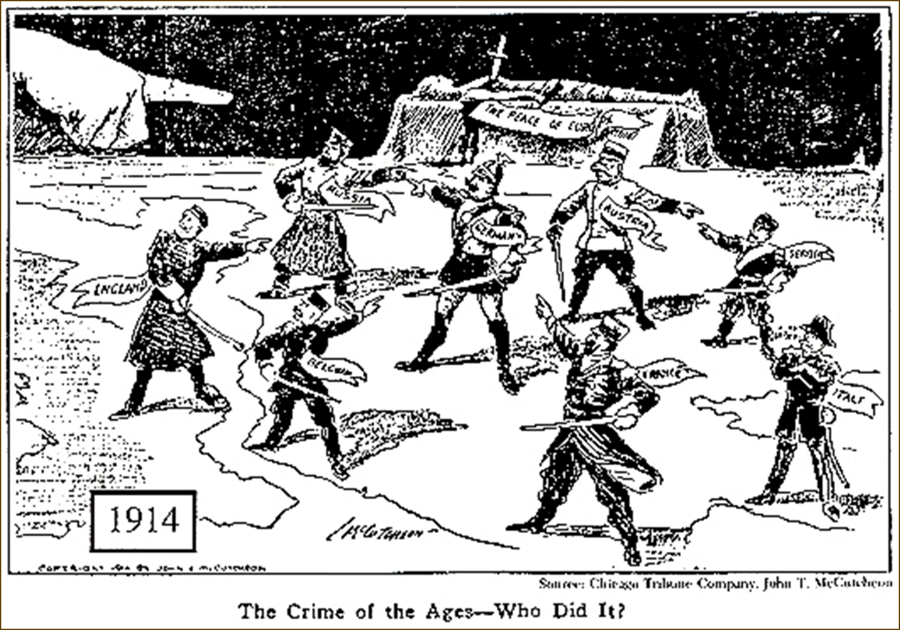
Causes of World War I
In 1914, war breaks out across Europe…how did they get to that point?

Slide 3
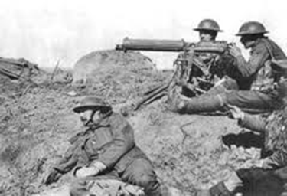
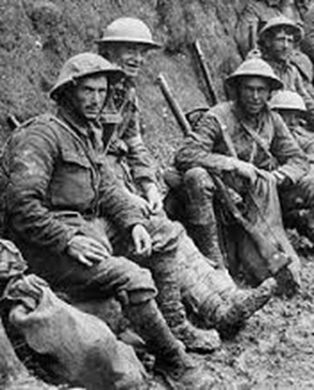
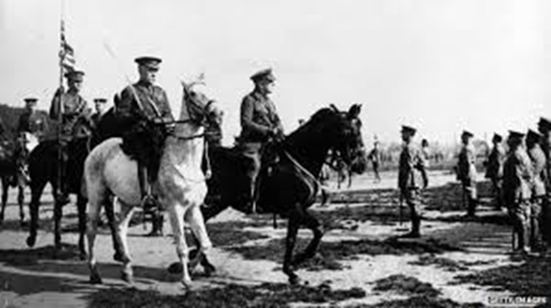
Causes of World War I
The four MAIN causes of World War I are…
M – Militarism
A – Alliances
I – Imperialism
N – Nationalism

Slide 4
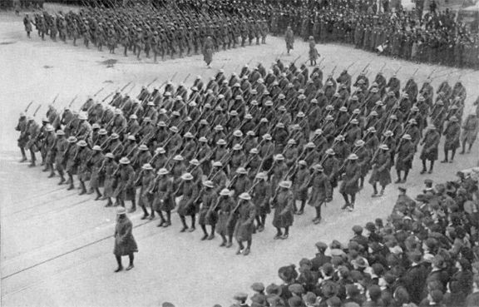
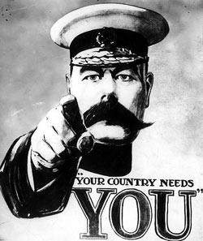
Causes of World War I
MILITARISM
As the 20th century (1900s) began, European countries began an “arms race”
Militarism: when a country believes they must maintain a strong military
Also believe they should use military force aggressively to defend national interests
Each country fought to have the most powerful military
By 1914, Germany had the greatest increase in military
Great Britain and Germany both had very strong navies
Industrialization: starting in the 1800s to the start of the war, Europe went through a period of Industrialization
Increased military materials and new technology being produced

Slide 5
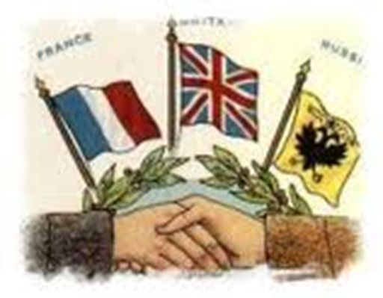
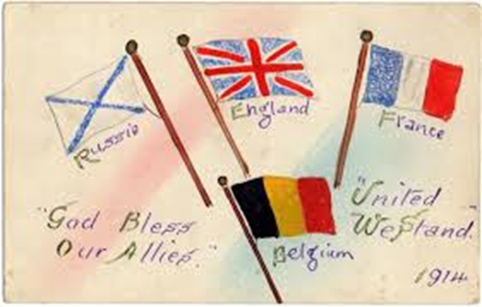
Causes of World War I
Alliances
European countries began to join alliances to protect themselves
Alliances: agreements between two or more countries to help each other during a war or a conflict
European countries began to make these alliances because they were afraid of the increase in militaries and the increasing disagreements
No country wanted to be alone in case a war started
Unfortunately, alliances dragged more countries into the war

Slide 6
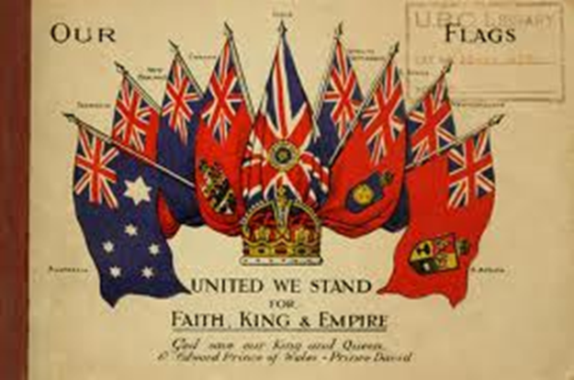
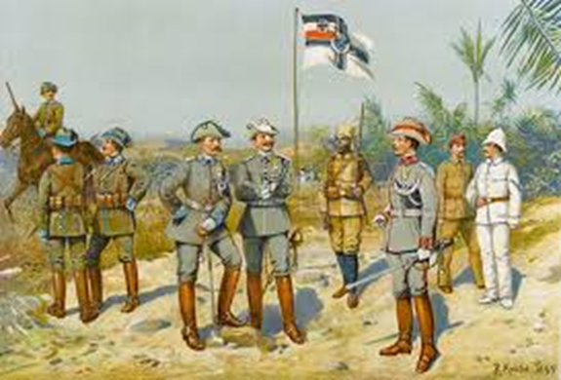
Causes of World War I
Imperialism
Leading up to World War I, European countries were fighting over land in Africa and Asia
Each country wanted the territory for the natural resources, man power, and strategic locations they offered
The existing competition led to increasing negative feelings and confrontations between countries

Slide 7
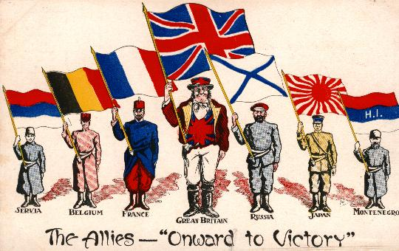
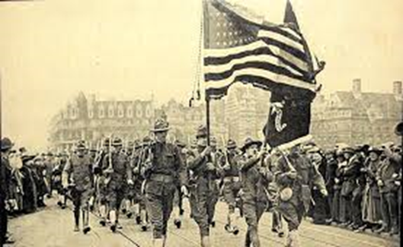
Causes of World War I
Nationalism
Nationalism: having extreme pride of and love for your country
Also being willing to defend your nation no matter what the situation
Nations would seek their own interests over others
During Imperialism and at the start of the 20th century there was strong sense of nationalism
Europeans were very proud of their countries
Other countries, like Serbia, were fighting for their independence
Austria-Hungary controlled them

Slide 8
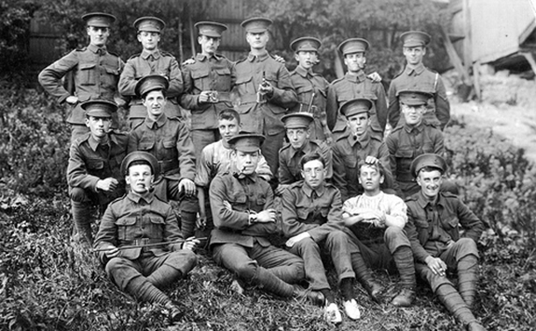
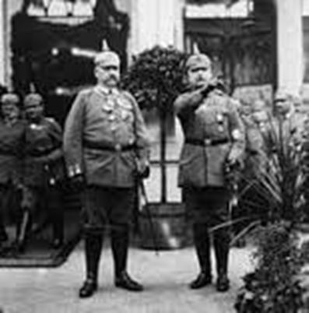
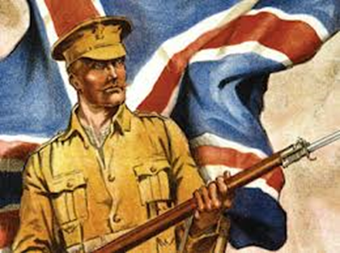
Road to War
Militarism, Alliances, Imperialism, and Nationalism set the stage for a combative continent ready to fight at any point
One event was all that it took to start a war across Europe....it was a “Powder Keg” ready to explode
....what happened to start World War I?

Slide 9
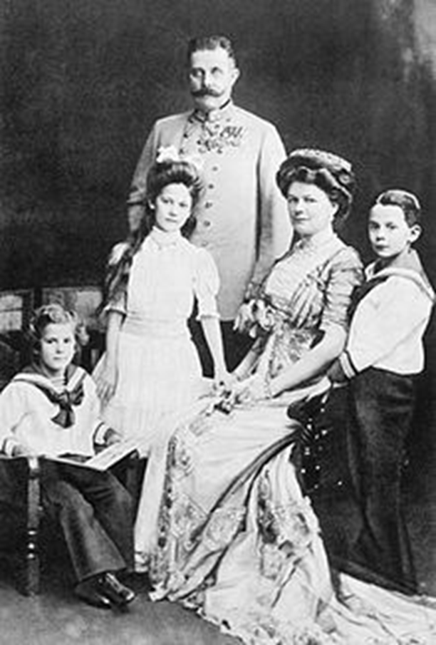
Assassination of Franz Ferdinand
Archduke Franz Ferdinand
Prince of Austria Hungary
His country ruled over Serbia, which was part of its empire
In the summer of 1914, Franz Ferdinand and his wife visited Serbia on a diplomatic trip for Austria-Hungary

Slide 10
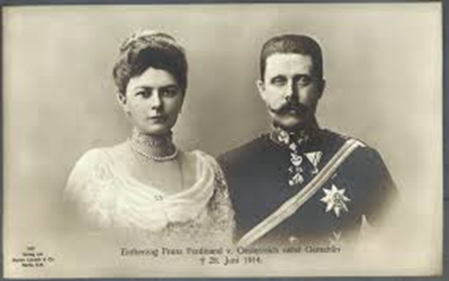
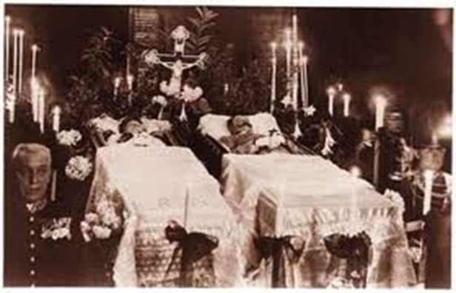
Assassination of Franz Ferdinand
On June 28, 1914, Franz Ferdinand and his pregnant wife Sophie were assassinated in Sarajevo
Assassination = a sudden or secret attack that kills someone of prominence
Members of a nationalistic group called the “Black Hand” planned the assassination
The assassination started a domino effect of disputes and reactions, shattering world peace.

