Slide 1
World War I

Slide 2
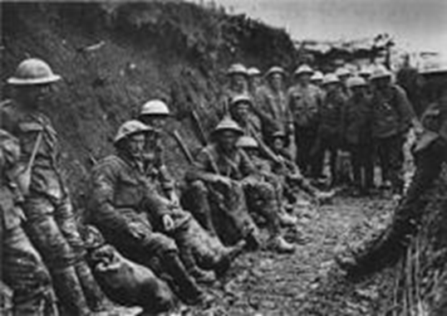
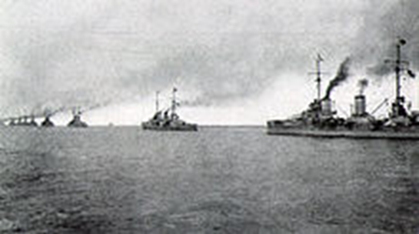
World war I
In 1914, World War I started in Europe. It began as a conflict between the countries of Austria-Hungary and Serbia, but quickly turned into a global war between 32countries.
From July 1914 to November 1918
22 million people (soldiers and civilians died)
Also called the “Great War” or the “War to End All Wars”
Militarism, Alliances, Imperialism, and Nationalism (MAIN) set the stage for a war.
One event was all that it took to start a war…it was a “Powder Keg” ready to explode
…what happened to start World War I?

Slide 3
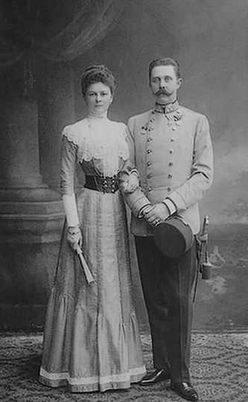
World war I
Assassination of Archduke Franz Ferdinand
Archduke Franz Ferdinand
Prince of Austria-Hungary
His country ruled over Serbia as part of its empire
In the summer of 1914, Franz Ferdinand and his wife, Sophie travelled to Serbia
On June 28, 1914, Franz Ferdinand and his wife were assassinated in Sarajevo, Serbia
Assassination: a sudden or secret attack that kills someone of importance
Members of a Serbian nationalistic group called the “Black Hand” planned the assassination
The assassination started a “Domino Effect” of disputes and reactions, shattering world peace

Slide 4
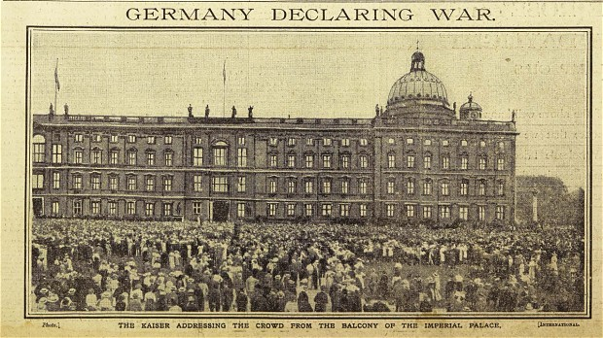
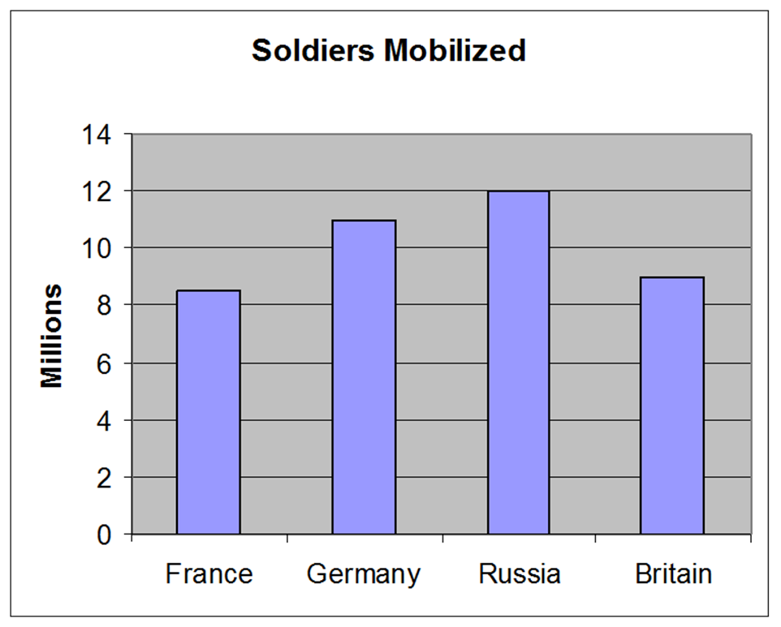
World war I
Road to War…
Following the assassination, Austria-Hungary demanded action be taken against Serbia and countries took side based on alliances
When no agreement was made, countries took sides to go to war
Germany and Italy were allies with Austria-Hungary
France, Russia, and Great Britain (UK) wanted to defend Serbia
In 1917, the United States joined the war after Germany sunk their passenger ship, the Lusitania

Slide 5
World war I

Slide 6
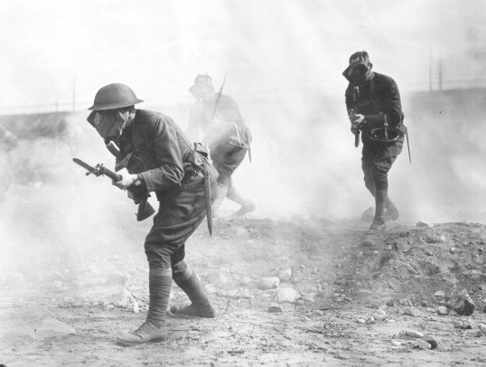
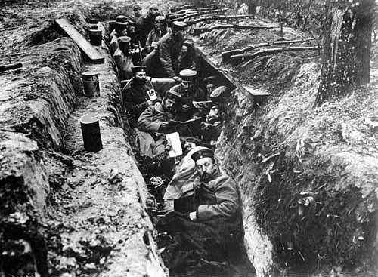
World War I was different from other wars previously fought by Europeans
New Technology
Machine guns
Poisonous Gas
Tanks
Airplanes
War of Attrition: war strategy where victory is based on killing more enemy soldiers and destroying more enemy supplies
Goal is to completely deplete enemies resources (soldiers and supplies)
Trench Warfare: a type of warfare where soldiers dig trenches to live in and attack over an open area
Very deadly, but little change/movement
“__________________________”: area between the two enemy trenches

Slide 7
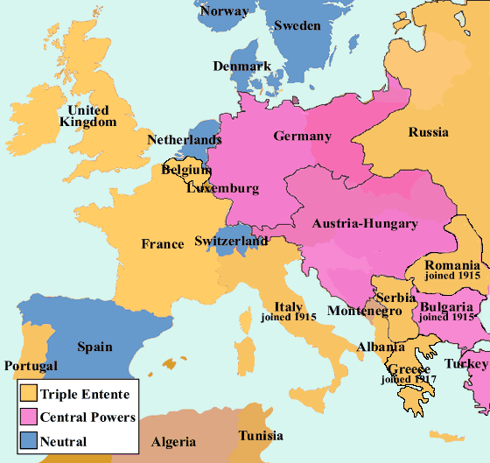
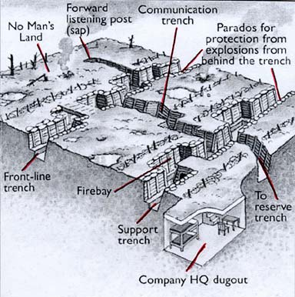
World war I
On July 28, 1914, Austria-Hungary invaded Serbia, causing Russia and Germany to mobilize their armies
Germany invaded Belgium to advance towards France (Schlieffen Plan)
This caused Great Britain (UK) to declare war on Germany
Germany advanced towards Paris, but was stopped in eastern France
The armies dug trenches, making the “Western Front”
Eastern Front: battle front in eastern Europe where Russians fought against the Axis Powers (Germany, Austria-Hungary, and Italy)

Slide 8
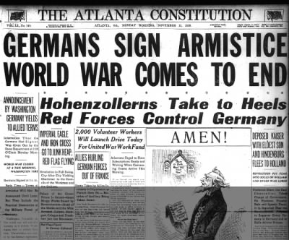
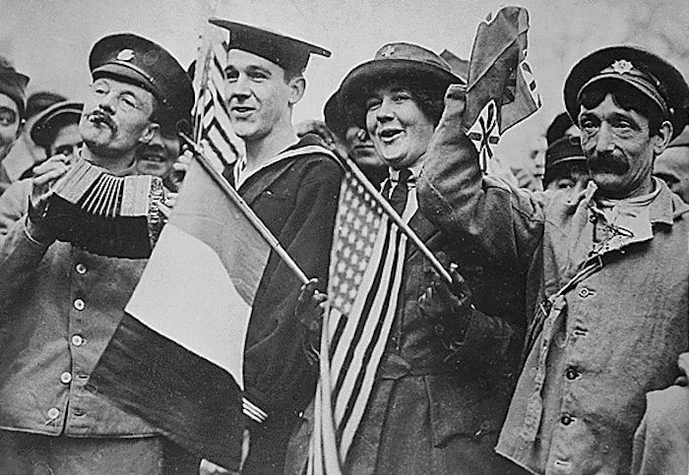
World war I
End of World War I
“The War to End All Wars” came to an end in _______________________ 1918
Officially ended on the 11th hour of the 11th day of November (11th month)
Nations agreed to an armistice, giving the victory to the Allied Powers (UK, France, and USA)
Armistice: formal agreement for countries to stop fighting
Russia had withdrawn from the war in 1917 due to revolution at home

Slide 9
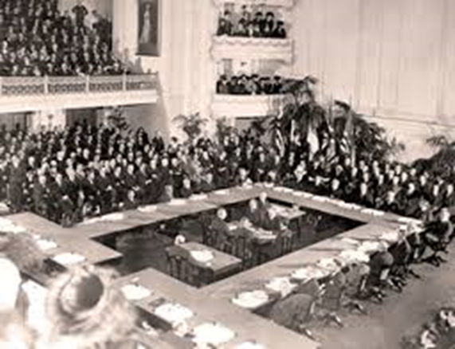
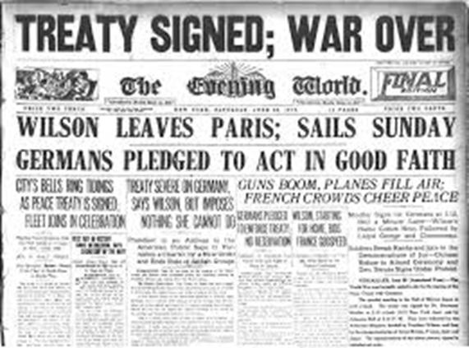
World war I
The Treaty of ___________________ was the official agreement to end World War I.
After signing the treaty, Germany had to…
Accept complete blame/responsibility for the war
Pay reparations to the other countries for damages ($33 billion)
Give up large parts of their territory and colonies
Not have a military
The treaty made Germans very mad and resentful towards the other countries
It also caused economic problems for the country after the war ended

Slide 10
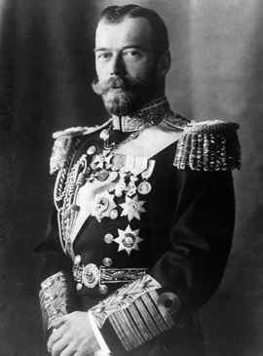
Russian Revolution
Czar Nicholas II
In 1917, Nicholas II was the Czar of Russia. He ascended to the throne in 1894 without realizing that he would be the last Czar of Russia.
The Romanov family has ruled Russia as an autocracy for over 300 years.
Problems in Russia
During World War I, Russia did not do well…
Millions of soldiers were killed while citizens were starving from food shortages
Citizens were unhappy
Russia seemed to be losing the war, because their soldiers were poorly trained and supplied

Slide 11
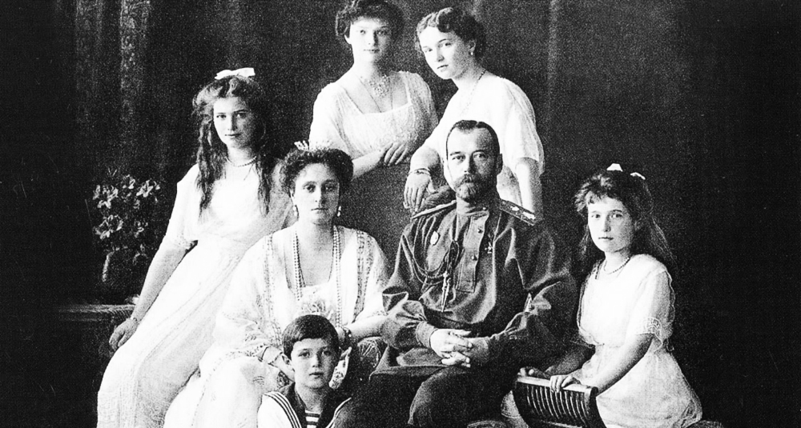
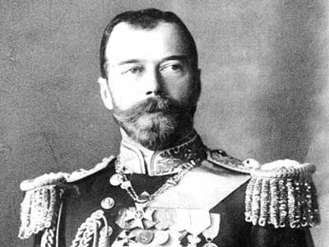
Russian Revolution
Riots in Russia
In early 1917, there were riots in the streets of Russia
Citizens demanded change in the government and an end to the war
Czar Nicholas II and his family were captured and imprisoned while a temporary government was set up.

Slide 12
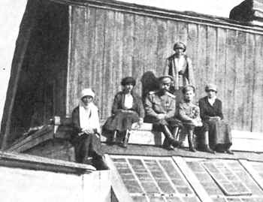
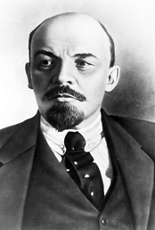
Russian Revolution
End of the Czars
In 1918, Czar Nicholas II, his wife, and their 5 children were all ________________, ending the Romanov dynasty.
Establishment of the Soviet Union
After multiple rebellions and temporary governments, the Soviet Union was established in 1922.
Communist government
Led by Vladimir Lenin

