Slide 1
Trade Barriers

Slide 2
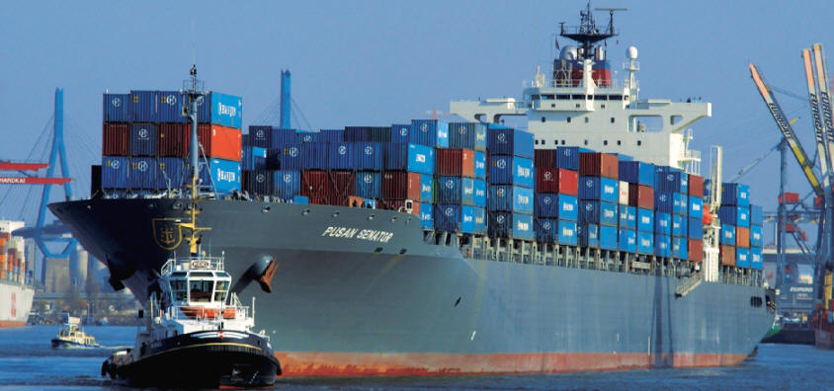
Vocabulary
Trade: voluntary exchange of goods and services between people and countries

Slide 3
Vocabulary
Imports: goods/products bought from other countries
Exports: goods made in your country but sold to other countries

Slide 4
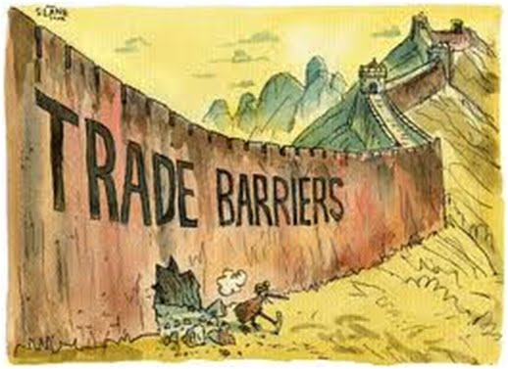
Vocabulary
Trade Barriers: ways that a country controls, limits, or prevents trade with other countries

Slide 5
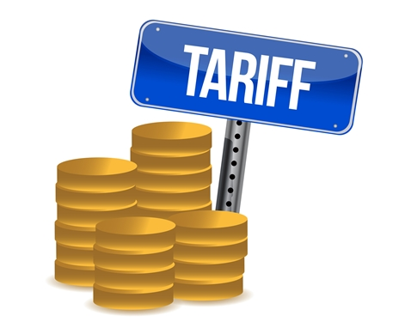
Tariff
A tax on imports (products from other countries)
Used to…
Limit trade with other countries
Help businesses in their country by increasing the prices of products imported from foreign countries
The tax increases the price so companies don’t lose $

Slide 6
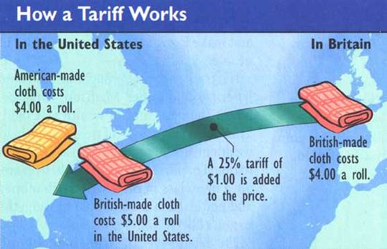

Slide 7
Quota
A specific limit put on how much of a good or product can be imported from another country in a specific amount of time
Used to…
Protect businesses in your own country
Country A’s economy relies on farming and selling Sugar Cane….but Country B is now selling Sugar cane to Country A and Country A’s businesses are suffering. To help their domestic companies, Country A’s government places a quota on how much Sugar Cane can be imported from Country B

Slide 8
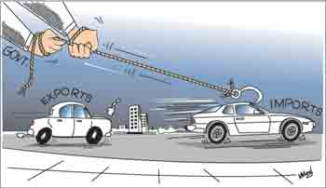

Slide 9
EMbargo
Government order stopping trade with another country.
Used to…
Put financial pressure on another country that your country does not agree with or approve of
Example: The United States put an embargo on Cuba, because they had a Communist government the US did not agree with. The US hoped it would force Cuba to change to a Democracy
Embargos are not successful if the country it is placed on still has other trade partners

