Slide 1
Map Skills
What is a map? What important elements are on a map?

Slide 2
Globes & Maps
To learn about the Earth, there are 2 tools you can use… globes and maps!
A globe is a model of the planet Earth as if you were seeing it from outer space
A globe is round and shows the continents and oceans
A map is a model of the Earth or a specific place on the Earth shown on a flat surface
Maps are useful because you can carry them with you!
Cartographer: a person who makes maps

Slide 3
Elements of a Map
Every map has 5 important elements…
Title (tells you exactly what the map is showing!)
Legend/Key
Compass Rose
Scale
Inset map

Slide 4
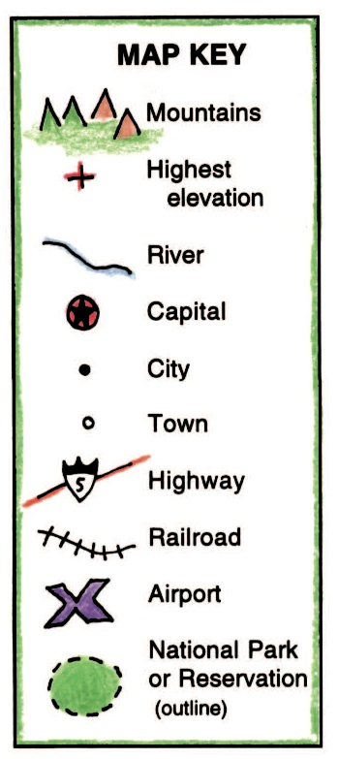
Elements of a Map: Map Key
Map Key or Legend: explains what certain symbols, dots, or colors on a map mean
For example, a star somewhere usually means it is a capital city (Atlanta in Georgia)
Or, a blue line may represent a river

Slide 5
Elements of a Map: Compass Rose
Compass Rose: a figure on a map that shows the cardinal directions (North, East, South, West)
North
East
South
West

Slide 6
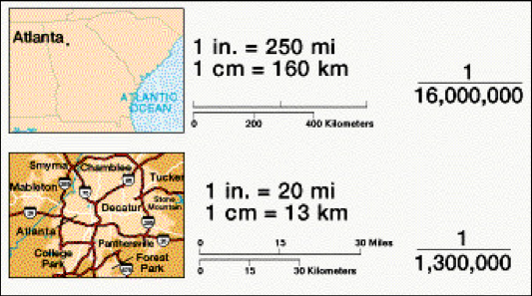
Elements of a Map: Map Scale
Map Scale: part of the map used to show the relationship of a distance on the map to the distance in real life
Example: 1 inch on the map = 100 miles on the Earth

Slide 7
Different types of maps…
Cartographer: a person who makes maps
All maps show certain places, BUT there are lots of different types of maps!
Some maps may show only the borders between countries…other will locate different physical features
Other maps show particular information like population, climate, or vegetation
Two types of maps we will study are Physical Maps and Political Maps

Slide 8
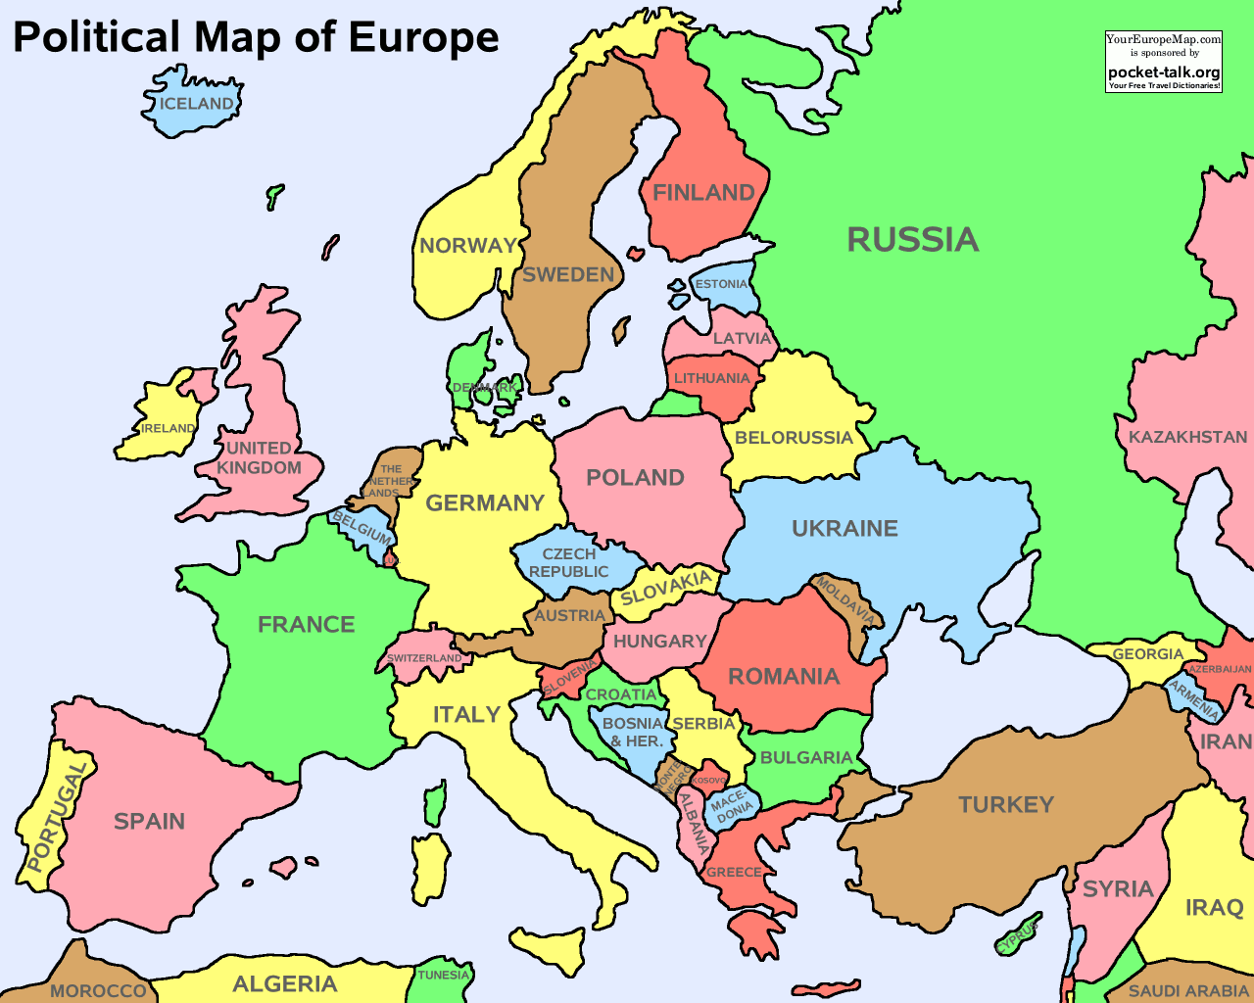
Political Maps
A Political Map is a map that shows the borders between countries
They also show the locations of continents, countries, states, cities, and towns.
Political Maps show features created by humans, not nature!

Slide 9
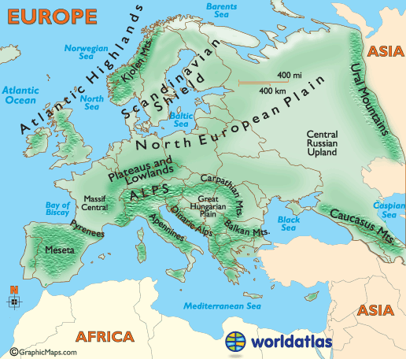
Physical Maps
A Physical Map shows different physical features or landforms
Mountains, rivers, oceans, forests, deserts, lakes, etc.
Physical Maps show features created mainly by nature!

Slide 10
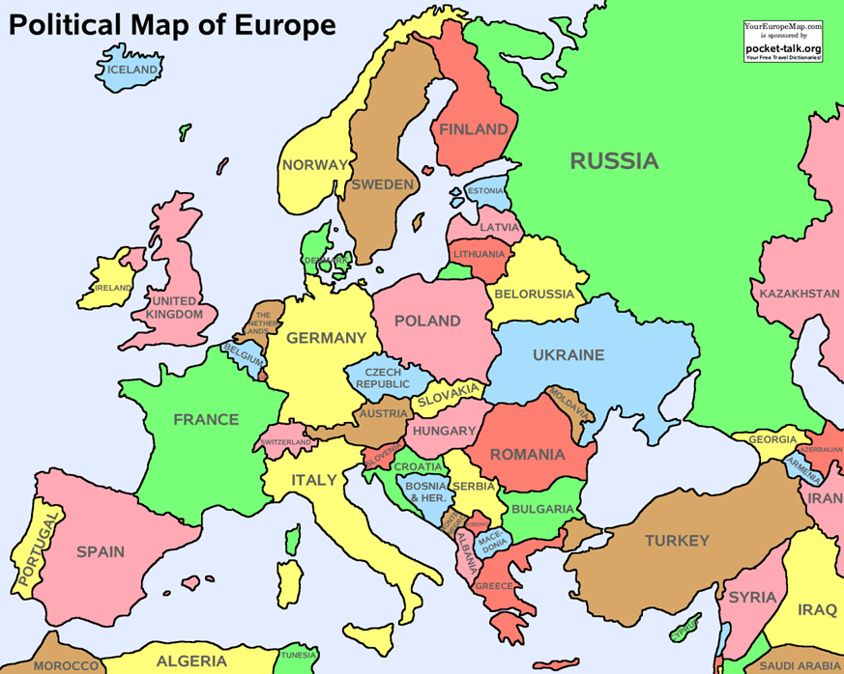

Slide 11
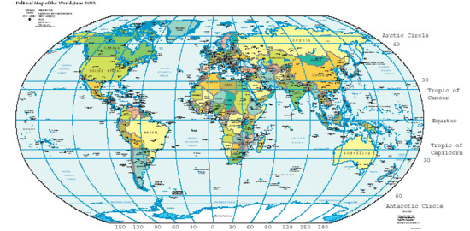
The Coordinate System: Longitude & Latitude
Coordinate System: on a map, imaginary lines create a system to determine an absolute location of any place on Earth

Slide 12
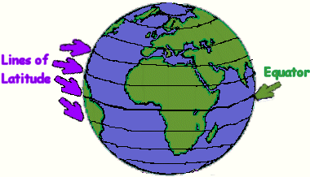
The Coordinate System: Longitude & Latitude
Latitude: imaginary lines that run from East to West
They measure degrees North and South of the Equator
Equator: line at 0 degrees Latitude
Divides the earth into Northern and Southern Hemispheres

Slide 13
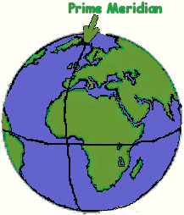
The Coordinate System: Longitude & Latitude
Longitude: imaginary lines that run from North to South
They measure degrees East and West of the Prime Meridian
Prime Meridian: line at 0 degrees Longitude
Divides the earth into Eastern and Western Hemispheres

Slide 14
