Slide 1
Introduction to Economics

Slide 2
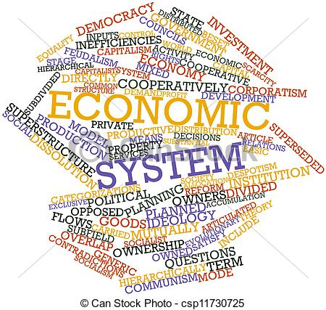
Economics
No country has every resource it needs or wants…this is called “Scarcity”.
Scarcity: the limited supply of something
Every country must decide how to distribute its resources to meet the needs of its people. They do this with their economic system.
Economic System: the way a country produces, distributes, and trades its goods or resources

Slide 3
Economics
Every economic system must answer 3 questions:
What goods and services will be produced?
How will the goods and services be produced?
Who will be able to consume those goods and services?

Slide 4
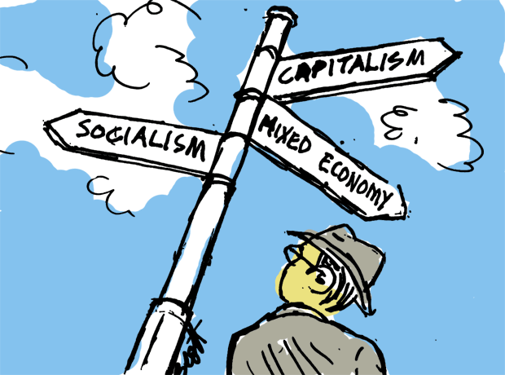
Economics
The way a society answers those 3 questions decides what economic system they have. There are 3 different economic systems:
Traditional Economy
Command Economy
Market Economy

Slide 5
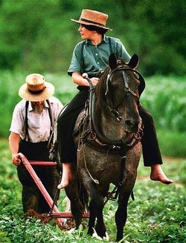
Traditional Economy
Economic system where customs and traditional habits determine what and how will be produced.
Jobs/responsibilities are passed down in families or decided early on
If your father was a farmer…you would be a farmer

Slide 6
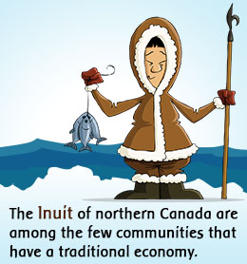
Traditional Economy
It is very rare to find traditional economies today
Agricultural societies
Farming, Hunter-gatherers, or Cattle herding
Examples: Native American groups in North and South America before European colonization.

Slide 7
Command Economy
Economic system where the government controls what is produced, how it is produced, and how much is produced.
The government owns the resources and decides who can get them
The government also determines wages for workers and the prices of the goods/products
Workers at a business are told what to produce and how much to produce
Quota: government imposed limit on how much of something must be produced (made) or traded (sold)

Slide 8
Command Economy
Command Economies have both good and bad aspects
Cons: it is hard to predict what the country will need or want
Factories may focus on making something the country doesn’t need
Pros: prices are controlled so citizens always know how much it costs
Healthcare and education are provided at no or little cost
Communism: a political and economic system where the government owns and controls most things (money and goods are then distributed)
Cuba – the government owns all factories and most farms
Soviet Union

Slide 9
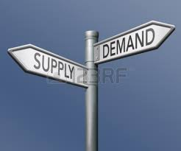
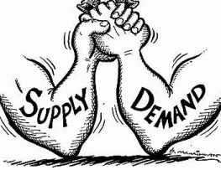
Market Economy
Economic system where decisions are made based on the change in prices or the demands of both buyers and sellers
Supply and Demand: concept that an economy should be based on how much of something there is available (supply) and how badly people want the product (demand)
Prices would go up and down based on demand
People are free to own their own businesses and to decide what to produce, what to charge, and what to purchase.

Slide 10
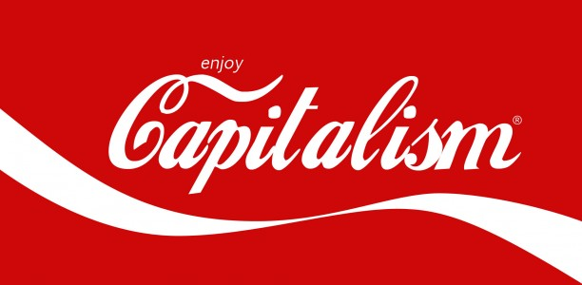
Market Economy
Market economics have both benefits and problems…
Pros: customers buy what they want and businesses are not controlled by the government
Cons: prices can be too high or businesses frequently go out of business
A Market Economy is also known as Capitalism, Free Enterprise, or Laissez-Faire
Capitalism: businesses and trade are completely controlled by private businesses (no government control)

Slide 11
Mixed Economy
There are no pure command or market economic systems today. All modern economies use parts of each and are called Mixed Economies
However, each Mixed economy will be different from each other
Mixes parts of both command and market economies
In a pure market economy, the government would not be involved at all.
In mixed economies, the governments make laws to…
Protect workers from unfair treatment or low wages
Monopolies (no competition) are prevented by governments
If only one company provides a service, prices go up

Slide 12
Command Economy Market Economy
Cuba Venezuela Brazil Canada

