Slide 1
Gross Domestic Product & Factors of Production

Slide 2
Gross Domestic Product
Gross Domestic Product (GDP): the total value of all of the goods and services produced in a country in one year
The GDP helps to show wealthy or poor a country is or if the country’s economy is growing or getting worse
GDP Per Capita: the amount of wealth in a country per person in a country (GDP divided by each person in a country)

Slide 3
Gross Domestic Product
If a country has a higher GDP, then the country is wealthier
Standard of Living: the amount of wealth and necessary materials to survive (water, food, shelter, clothing, etc.) that are available to people
Raising the GDP usually increases the standard of living in the country

Slide 4
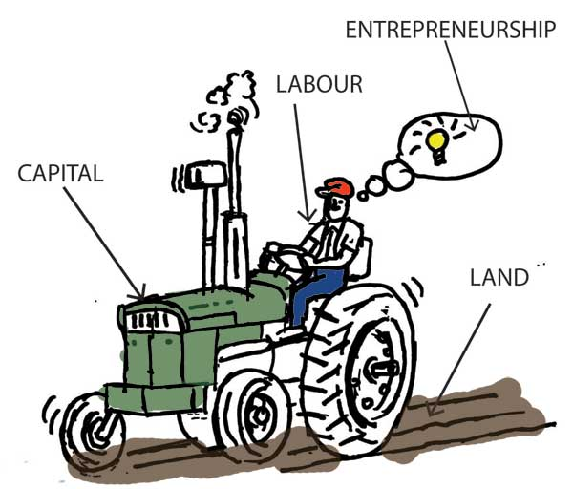
Gross Domestic Product
There are four basic factors that will influence a country’s GDP: Natural Resources, Human Capital, Physical Capital, and Entrepreneurship.
Investing in all of these factors will increase the country’s production and trade…which then increases the country’s GDP

