Slide 1
Economics Vocabulary

Slide 2
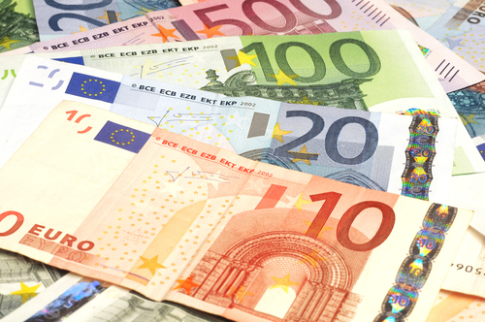
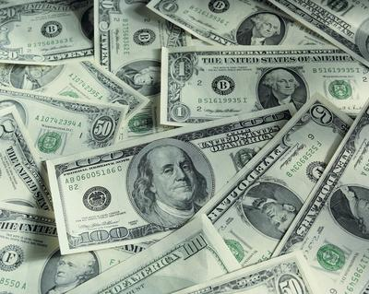
Currency
The type of money that a particular country uses
Example:
The European Union uses the Euro
In the United States, we use the American Dollar

Slide 3
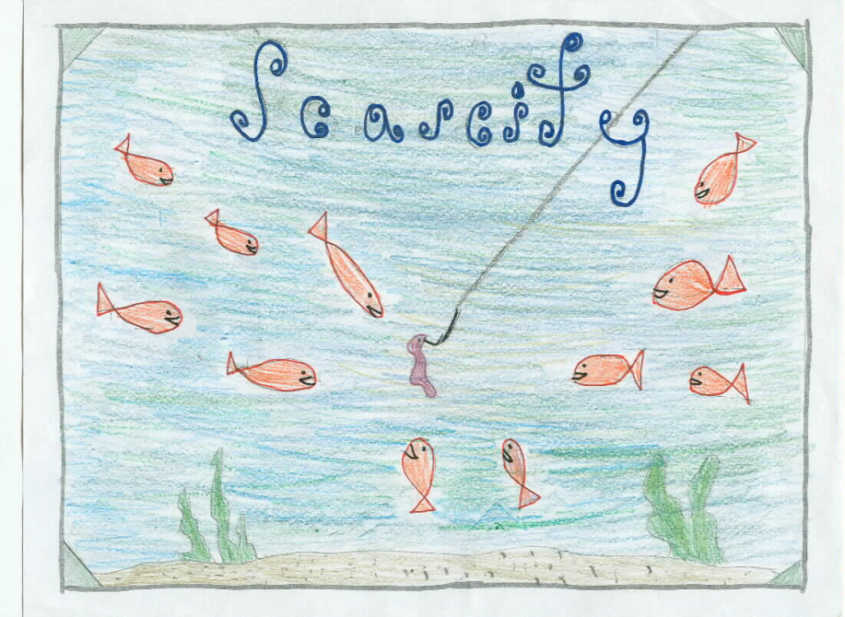
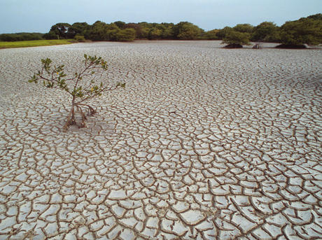
Scarcity
When there is not enough of something; when there is a shortage of a particular item
Example:
There is a scarcity of water in the desert

Slide 4
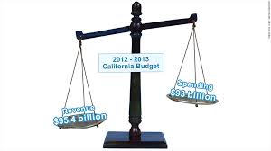
Surplus
When there is more than enough of something; when you have more than you need of an item
Example:
If you spend less than you make…that is a surplus

Slide 5
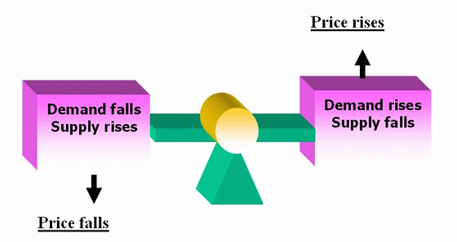
Supply & Demand
The theory that prices go up/down based on how much of something there is and how badly people want it
Example: if we have a blizzard, the prices of shovels and coats will go up

Slide 6
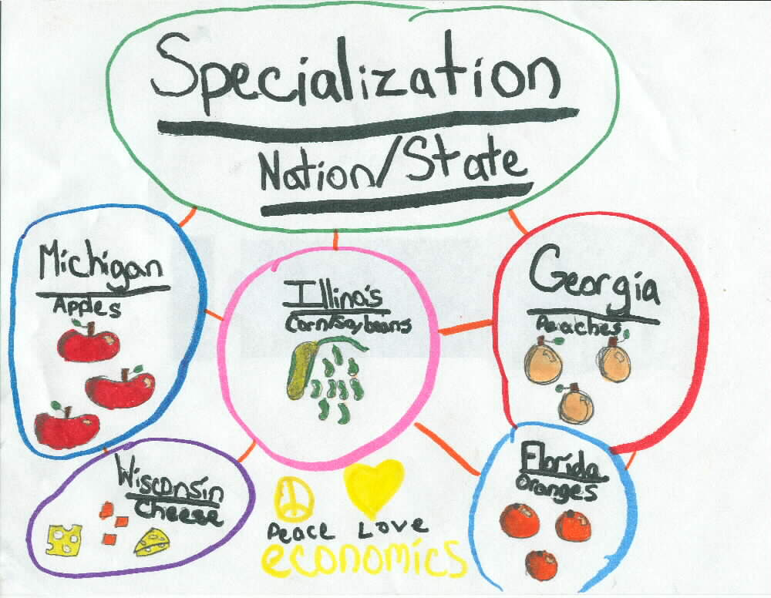
Specialization
When a country, business, or individual focuses on one thing they are very good at (Improves economy/income)
Example: country A focuses on producing cars, while country B focuses on producing sugar cane; they then trade with each other and maximize their profit

Slide 7
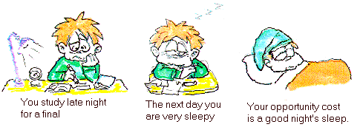
Opportunity Cost
The value of what you give up when you make a decision to produce, buy, or do something
Example: If a company decides to produce a computer, their opportunity cost is the value of the phone they did not produce

Slide 8
Gross Domestic Product
The total value of a country’s economy; the total of goods and services a country produces in one year
Represents how strong or how poor a country is or if their economy is improving
Countries with a higher GDP are wealthier and usually have a higher literacy rate; Countries with a lower GDP are poorer and usually have a lower literacy rate

Slide 9
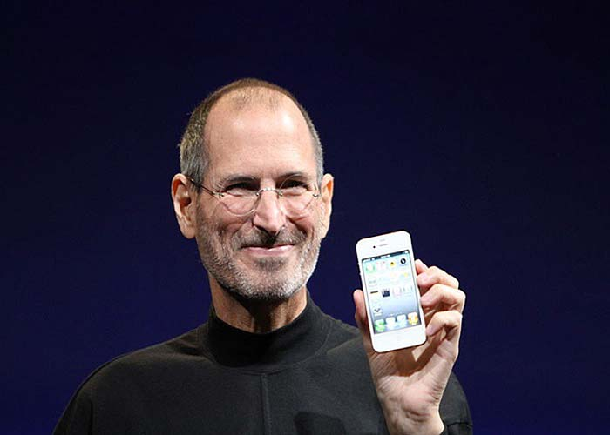
Entrepreneur
A person who takes a risk to come up with a new idea/product or to start a new company
Entrepreneurs take a risk (money…job…time)
Example: Bill Gates or Steve Jobs

