Slide 1
Currency & Personal Finance

Slide 2
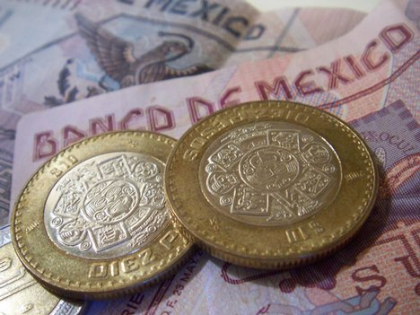
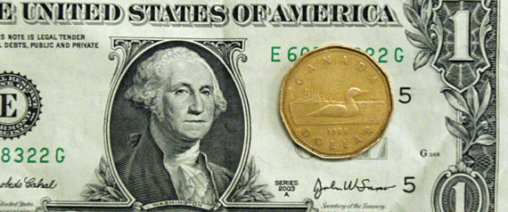
Vocabulary
Currency: the money that a country to countries use to buy or sell goods and services
Why do countries need to have a currency?
To be able to fairly and easily buy/sell things
To make trade easier
Examples:
United States – US Dollar
Canada – Canadian Dollar
Mexico – Peso
Brazil – Real

Slide 3
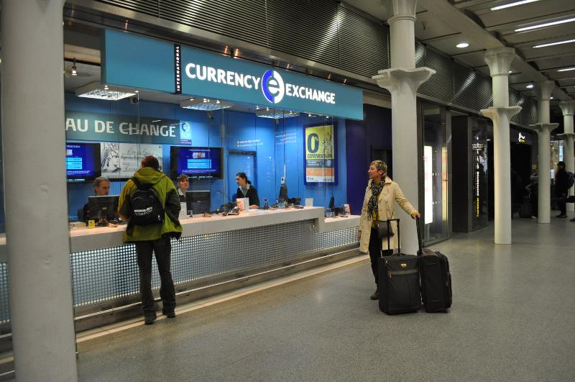
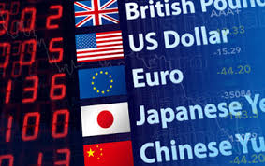
Vocabulary
International Currency Exchange: the exchange of currency between different countries (trading one type of money for another)
Why do people need to exchange their currency?
You can’t use your currency in another country that does not use it!
As you travel, you exchange money for the country you are in
Some countries use the same currency…like the European Union!

Slide 4
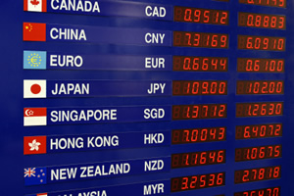
Vocabulary
Exchange Rate: the price of one country’s currency compared to the currency of another country; explains how much you will get when you trade money
How is an Exchange Rate determined?
Based on “Supply and Demand”…value of a country’s currency goes up and down based on the strength of their economy

Slide 5
Personal Finance Vocabulary
Money: the form of exchange used to buy certain goods and services
There are multiple forms of money
Currency (cash)
Coins
Credit
Debit Cards
Checks
Income: the amount of money that you earn from a job in a certain time period (usually one year)
Income gives you money to save or spend on whatever you need or want

Slide 6
Personal Finance Vocabulary
Spending: the amount of money that you choose to use in exchange for certain goods and services
Income provides people with money…people choose for themselves how they need to use that money
Savings: the amount of money that you have not spent after buying the things you need and/or want
Most people want to save money in case of an emergency or to save for future expenses/costs
Income – Spending = Savings

Slide 7
Personal Finance Vocabulary
Budget: a saving/spending plan that is based on a person’s income and their future expenses
People make a budget to make decisions on what they need to spend each month/year and how much money they can save
People must budget their necessities before the spend on luxuries
You only have a certain amount of money to spend based on your income
Debt: money that you owe to someone else or to a bank/business
Examples: mortgages, student loans, credit card debt
People always borrow money, but remember…you always have to pay it back!

Slide 8
Personal Finance Vocabulary
Credit: people use credit to buy something now and pay for it later on
When you buy something using credit, you have to pay back the money plus an added amount in interest
Interest: a fee paid for the use of someone else’s money over a certain amount of time
When you agree to borrow money on credit, you also agree to a percentage in interest to be added

Slide 9
Personal Finance Vocabulary
Investing: a form of saving where you put money aside now in order to receive a greater amount of money in the future
Examples: savings account, stocks, etc.
Investments gradually earn interest to become larger

