Slide 1
World Geography: Continents & Oceans
What are the 7 continents and 5 oceans? Where are these continents and oceans located?

Slide 2
Welcome to Geography!
Geography: the study of the location of places, the people who live in a certain area, and the environment of that area.
Physical Features: mountains, lakes, deserts, etc.
Climate (weather)
Culture
Environmental Problems

Slide 3
Continents of the World
Our world has 7 continents!
Continent: a large land mass or a large area of continuous land
The 7 continents are…
North America
South America
Africa
Europe
Asia
Australia
Antarctica

Slide 4
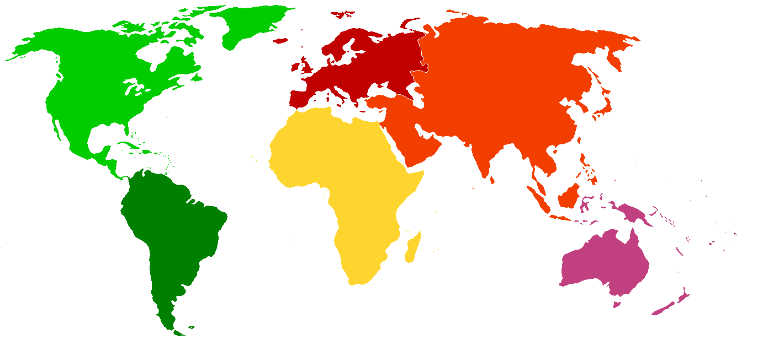

Slide 5
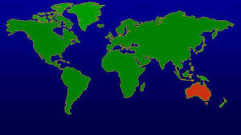
Australia
Australia is the only country that is both a country and its own continent
Most continents are divided into many different countries
Australia is the smallest continent

Slide 6
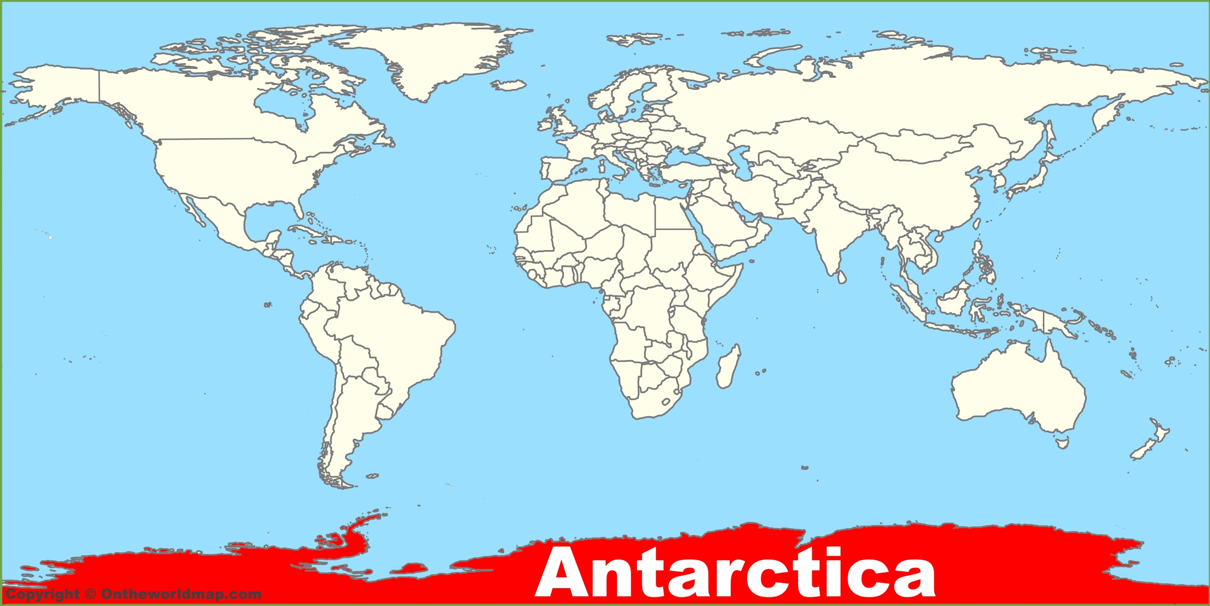
Antarctica
Antarctica is the southern most continent
Surrounded by the Southern Ocean
Only 135 residents and no official country/government

Slide 7
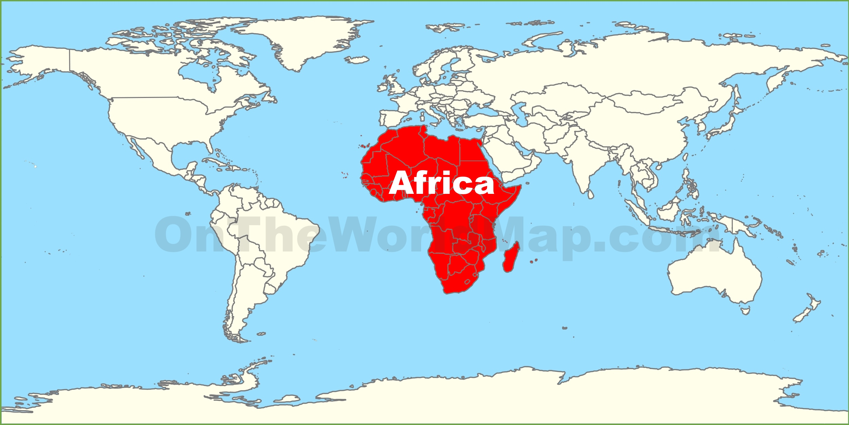
Africa
2nd largest continent and 2nd most populated continent
Bordered by the Atlantic Ocean, Indian Ocean and Southern Ocean

Slide 8
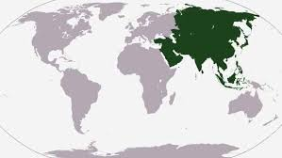
Asia
The world’s largest continent by both size and population
Bordered by the Pacific Ocean, Indian Ocean, and Arctic Ocean

Slide 9
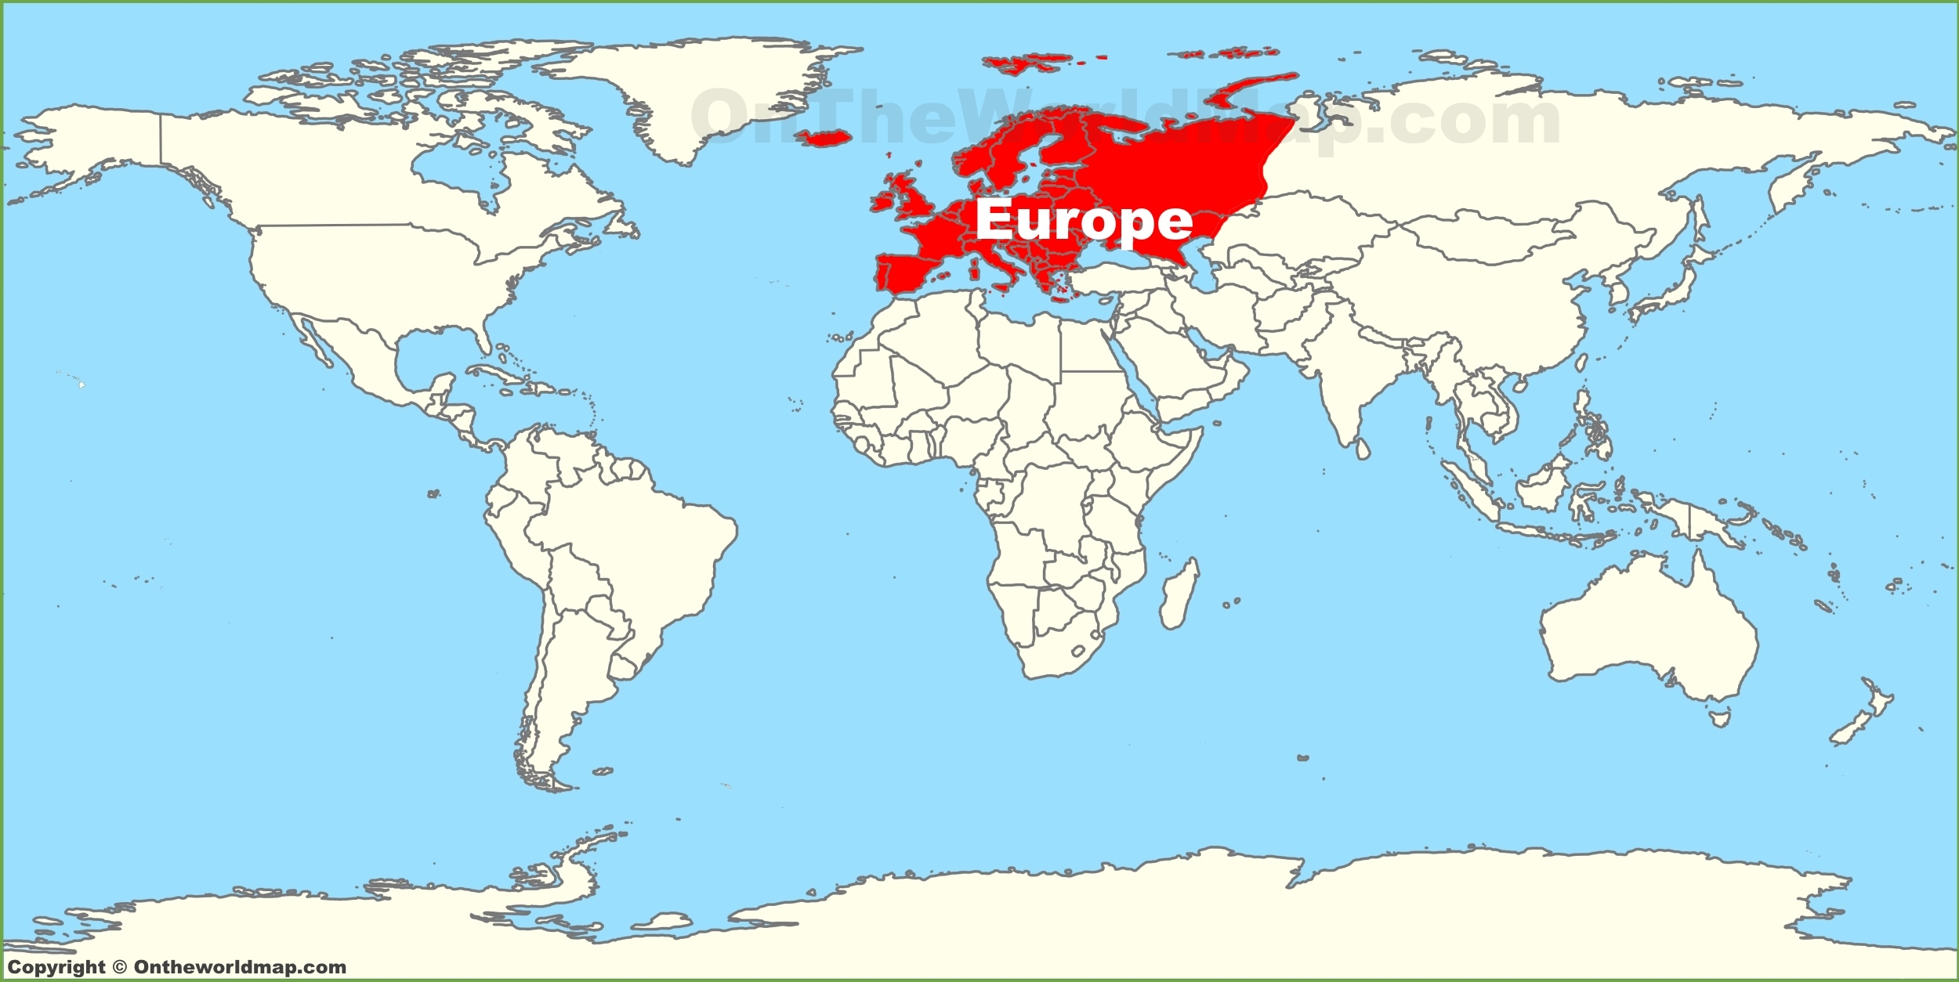
Europe
Europe is the 2nd smallest continent by land size, BUT the 3rd largest by population
That means…a lot of people in a smaller space!
Europe has about 50 different countries!

Slide 10
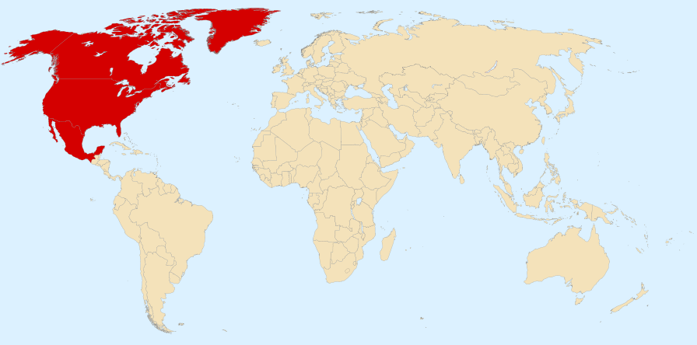
North America
3rd largest continent by land size and 4th largest by population
Includes the countries of Canada, the United States, and Mexico
Bordered by the Arctic Ocean, Pacific Ocean, and Atlantic Ocean

Slide 11
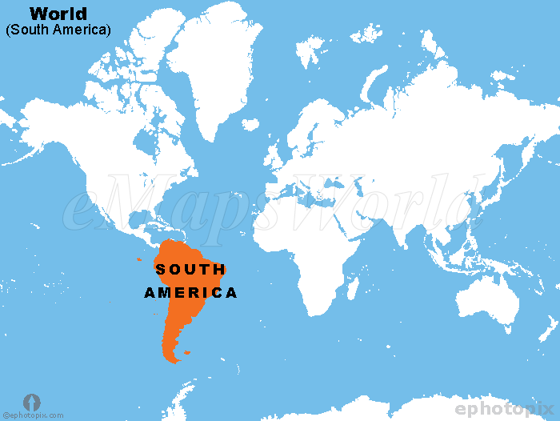
South America
4th largest continent by land size and 5th largest by population
Includes 12 different countries
Bordered by the Southern Ocean, Pacific Ocean, and Atlantic Ocean

Slide 12
Oceans of the World
Our world has 5 different oceans!
Arctic Ocean
Atlantic Ocean
Indian Ocean
Pacific Ocean
Southern Ocean

