Slide 1
Comparing Governments of Latin America

Slide 2
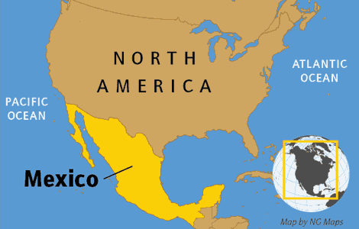
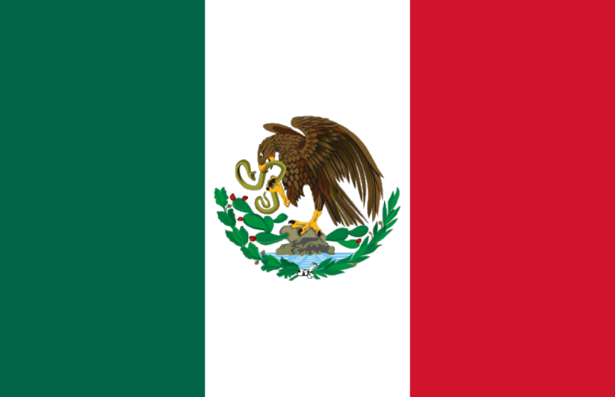
Mexico
Government of the United Mexican States
Mexico is a Federal Presidential Democracy
Federal: power is divided between the central government; state governments, and local governments
Presidential Democracy: citizens elect both the representatives and President

Slide 3
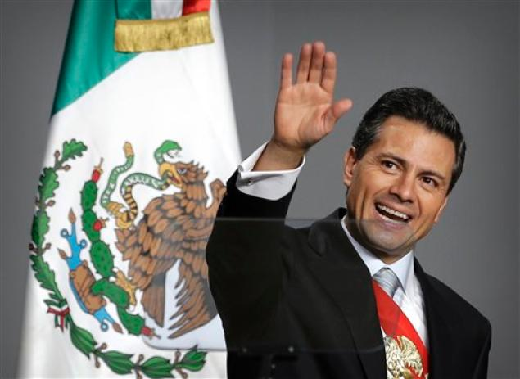
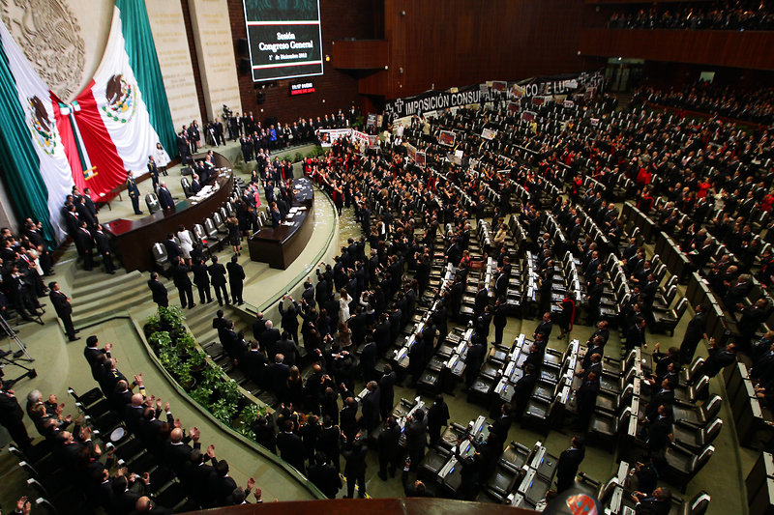
Mexico
Leader/Executive: President
President can only serve 1 term of 6 years
Legislature: Congress
Elected directly by the citizens

Slide 4
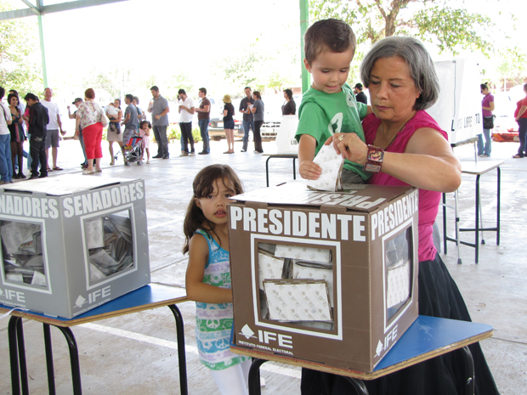
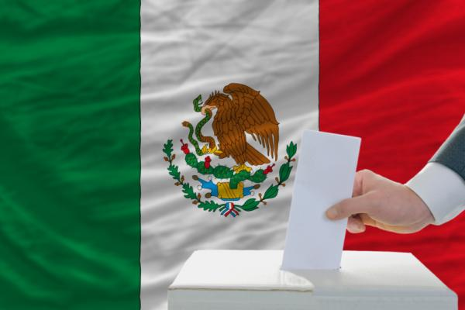
Mexico
Citizens’ Rights and Freedoms: Mexicans have many freedoms and an average level of freedom
Many political parties to choose from
Right to Vote
Citizens 18 or older can vote

Slide 5
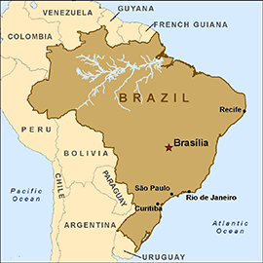
Brazil
Federative Republic of Brazil
Brazil is a Federal Presidential Democracy
Federal: power is divided between the central government and lower levels of government
Presidential Democracy: citizens elect both representatives and the President
Republic: government where people elect representatives in the government
Most power is given to the people

Slide 6
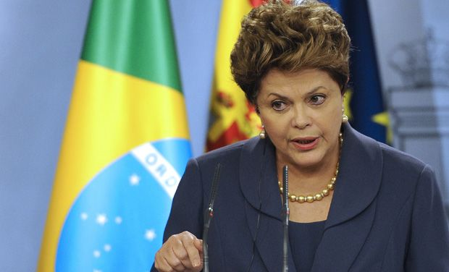
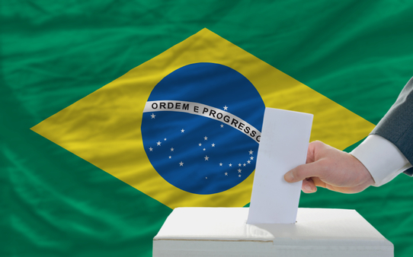
Brazil
Leader/Executive = President
Each term is 4 years
President can only be elected twice
Legislature = Congress
Citizens’ Rights and Freedoms: Brazilians have many freedoms and an average level of freedom
Right to Vote
Citizens can vote when they are 18
Mandatory (required) voting: citizens must vote when they are 18-70

Slide 7
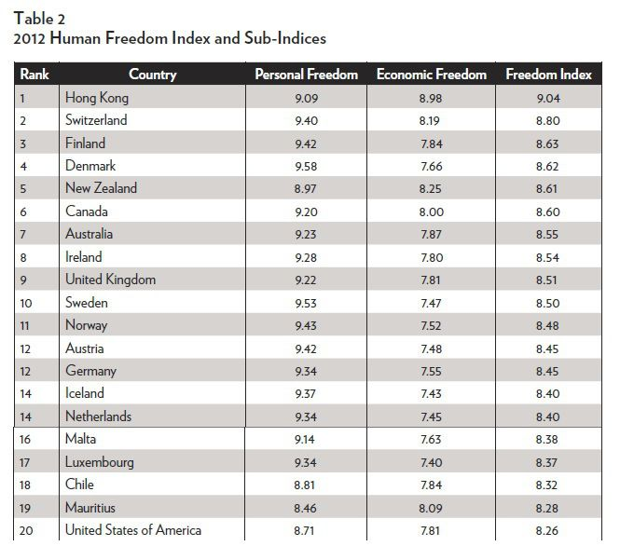

Slide 8
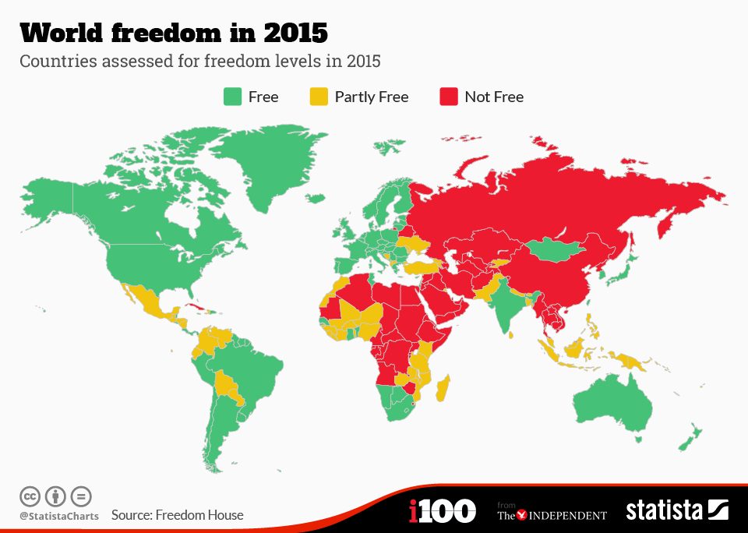

Slide 9
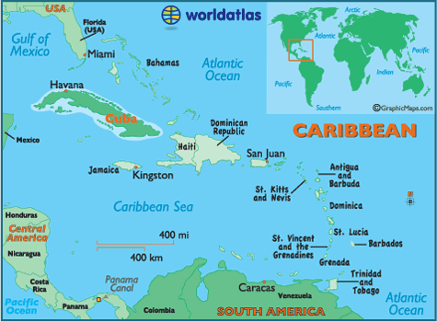
Cuba
The Republic of Cuba
Cuba has a Unitary Autocracy.
Unitary: all power is given to the central government
Autocracy: one ruler has all of the power

Slide 10
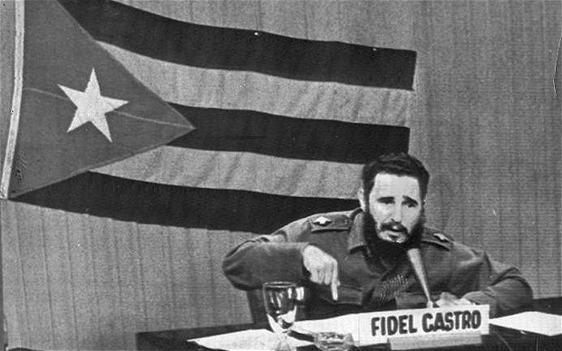
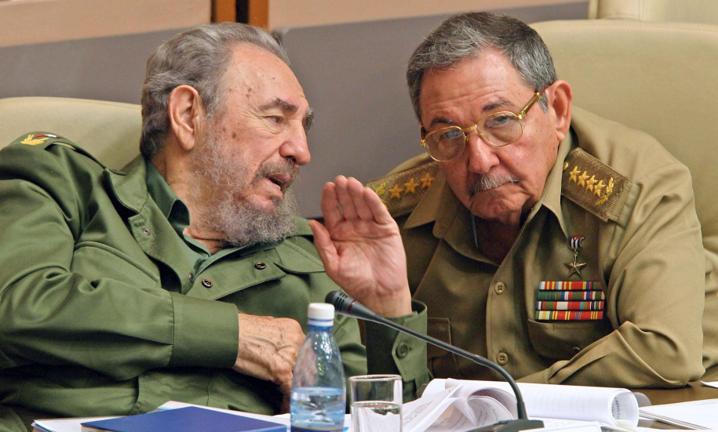
Cuba
Leader/Executive: President
Cuba’s leader is called the President, but he is actually a dictator
Fidel Castro took power by force in 1959
His brother, Raul became the President in 2008

Slide 11
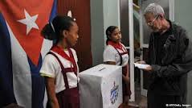
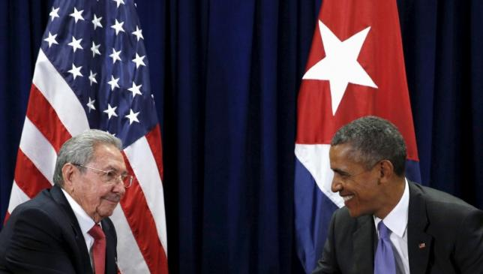
Cuba
Cuba is one of the least free countries in the world
The government controls almost everything
Businesses, factories, and farms belong to the government
Technically, citizens can vote
Voters have few options or choices
There is only one political party

