Slide 1
Comparing European Economies

Slide 2
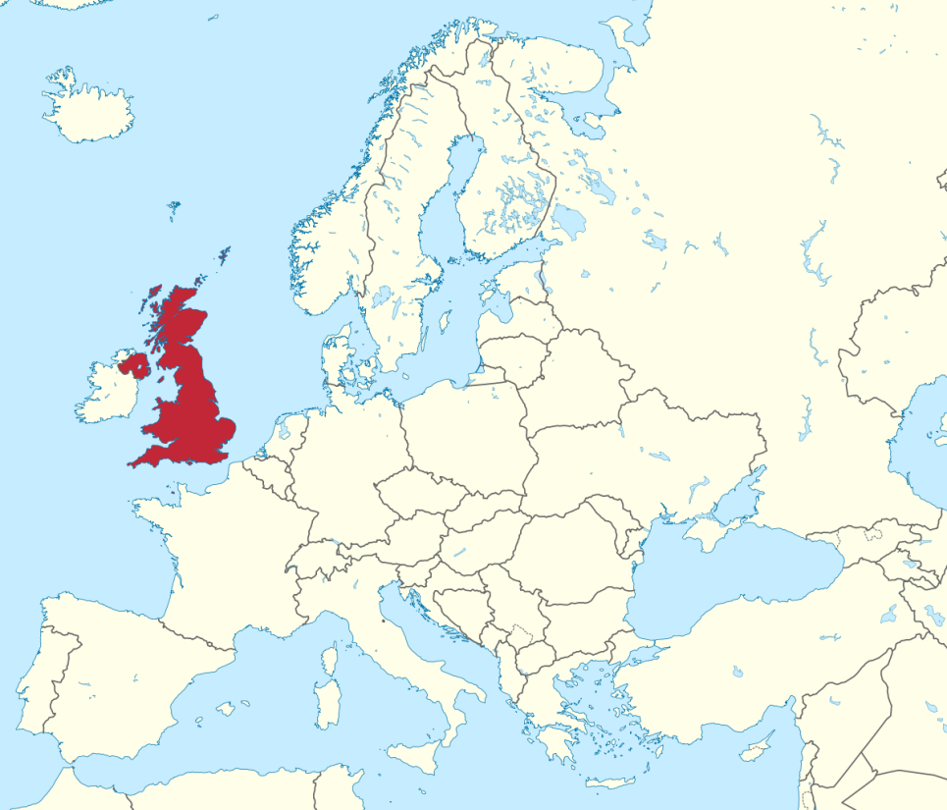
United Kingdom
Location
Small island nation including England, Wales, Scotland, and Northern Ireland
Separated from continental Europe by the English Channel
Population
64.1 million people
Currency
British Pound

Slide 3
United Kingdom
Economic System
The United Kingdom has a Mixed Economic System
Closer to a Market System than a Command
Private corporations or individuals own businesses
Since 1979, the British government has given up ownership of companies that used to be state-owned
The United Kingdom has the second strongest economy in Europe

Slide 4
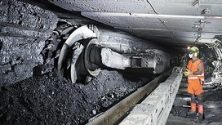
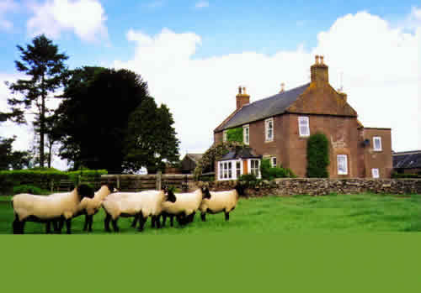
United Kingdom
Natural Resources
Coal, Oil, Natural Gas
Minerals (Iron)
Arable Land
25.9% of the land in the United Kingdom is good for growing crops
However…only 1% of the British people work in agriculture
The UK imports 1/3 of its food

Slide 5
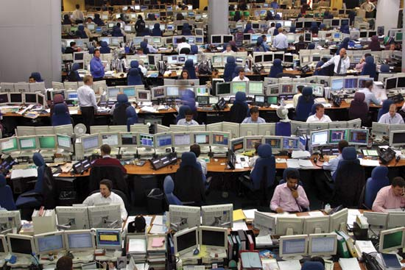
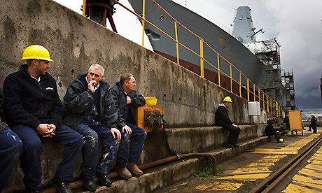
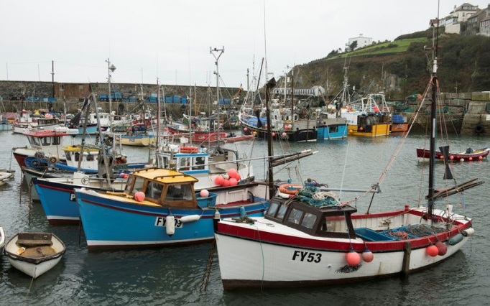
United Kingdom
Industries
Service Industries
Hotels/Restaurants, Education, Health care, Banking
Tourism
Mining and Manufacturing
Coal, Petroleum, Natural Gas, Iron Ore
Cars, Steel, Ships
Fishing

Slide 6
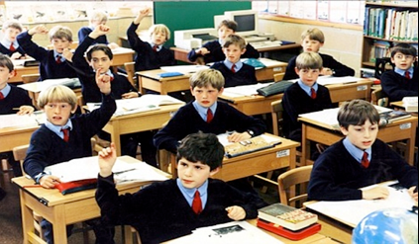
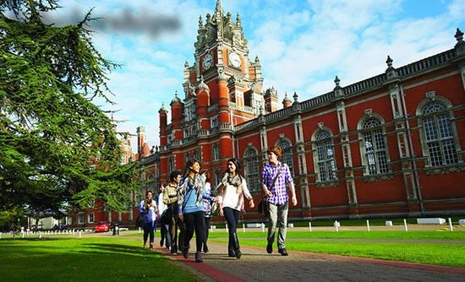
United Kingdom
Literacy Rate
99%
Education is mandatory from the ages of 5 – 16
Unemployment Rate
5.4%
Poverty Rate
20.5%

Slide 7
United Kingdom
Gross Domestic Product
$2.678 trillion
Gross Domestic Product
Per Capita
$41,787

Slide 8
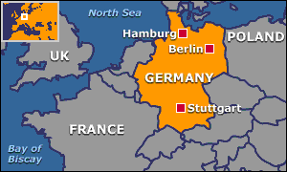
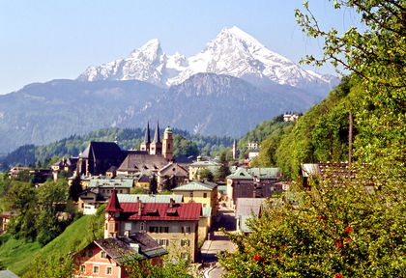
Germany
Location
North Central Europe
Bordered by the North Sea, Poland, Czech Republic, France, Belgium, and Austria
Population
80.62 million people
Currency
Euro

Slide 9
Germany
Economic System
Germany has a Mixed Economic System
Closer to a Market System
Social Market Economy
Combines a market system, some government controls, and social welfare for the poor
Germany has emerged as the strongest economy in Europe
In 1990, West Germany and East Germany reunified
West Germany had to absorb costs from the weak command economy of East Germany

Slide 10
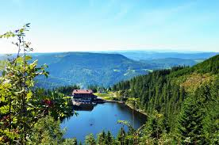
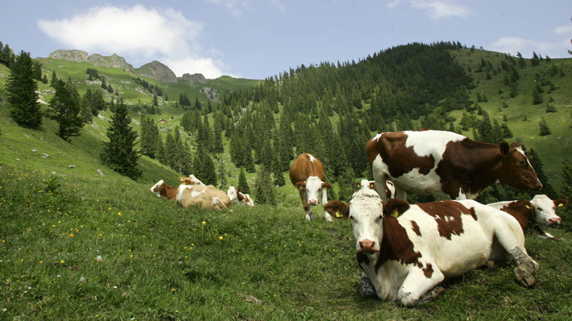
Germany
Natural Resources
Timber
Minerals (Coal, Iron Ore, Copper, Nickel)
Natural Gas
Arable Land
34.1% of land is good for farming

Slide 11
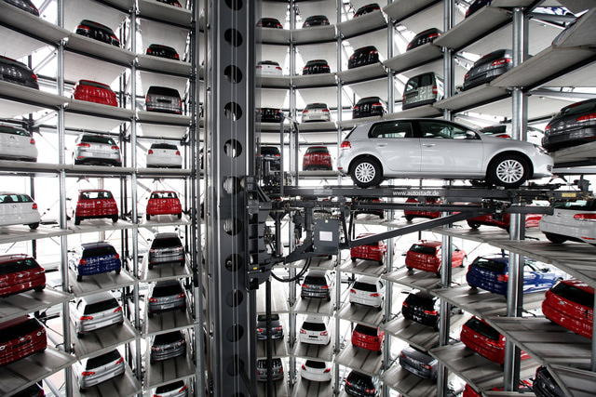
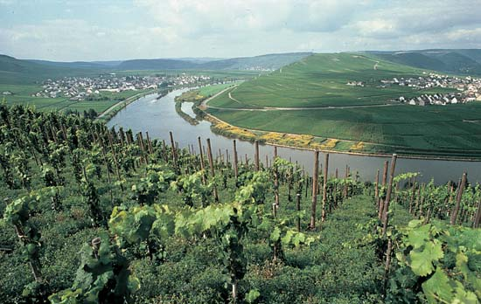
Germany
Industries
Agriculture
Mining
Coal, Iron Ore
Manufacturing/Factories
Steel, Automobiles, Building Materials
Factories mostly located along the Rhine River
Tourism

Slide 12
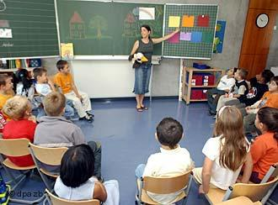
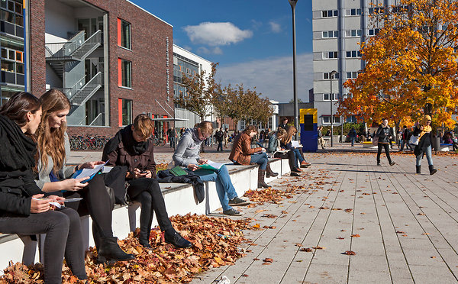
Germany
Literacy Rate
99.8%
Schools is mandatory from ages 6 – 18
Optional school is provided from ages 2 - 6
Unemployment Rate
4.7%
Poverty Rate
15.5%

Slide 13
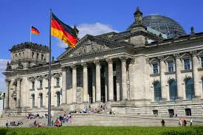
Germany
Gross Domestic Product
$3.73 trillion
Gross Domestic Product Per Capita
$46,268 per German citizen
18th best in the world

Slide 14
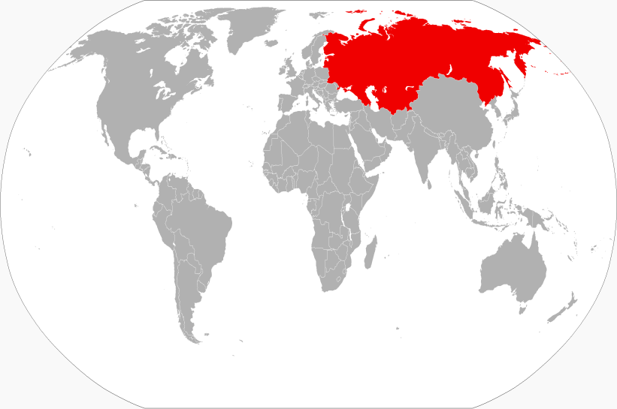
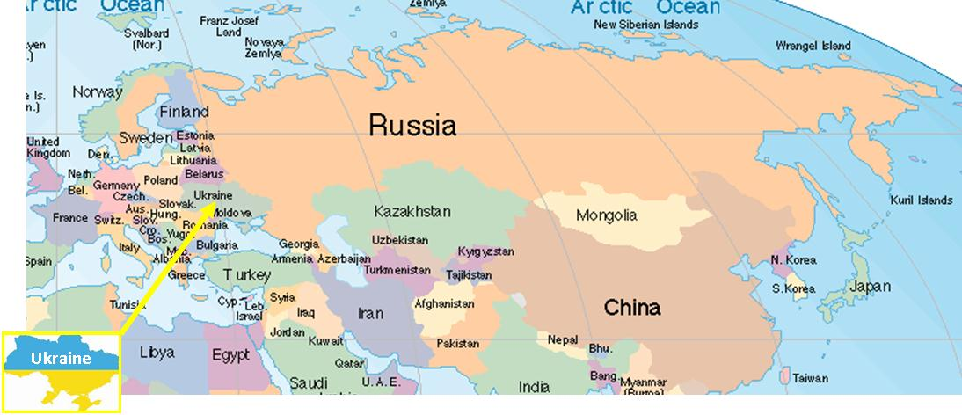
Russia
Location
Eastern Europe
Spans two continents (Europe and Asia)
Shares a border with 15 countries
Population
143.5 million
Currency
Russian Ruble

Slide 15
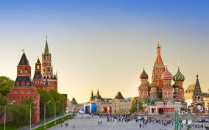
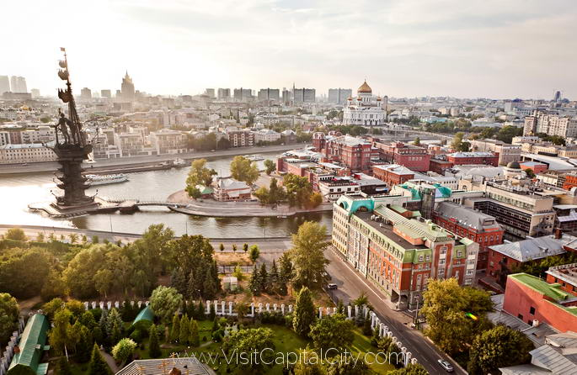
Russia
Economic System
Russia has a Mixed Market System
Russia is closer to a command than most other European countries
Russia has struggled transitioning from Soviet Union
Government controls some businesses and country has financial problems

Slide 16
Russia
Natural Resources
Timber
Almost 50% of land is forests
Minerals
Gold, Aluminum, Coal, Iron Ore
Arable Land
7.3 % of land in Russia is good for farming/growing crops

Slide 17
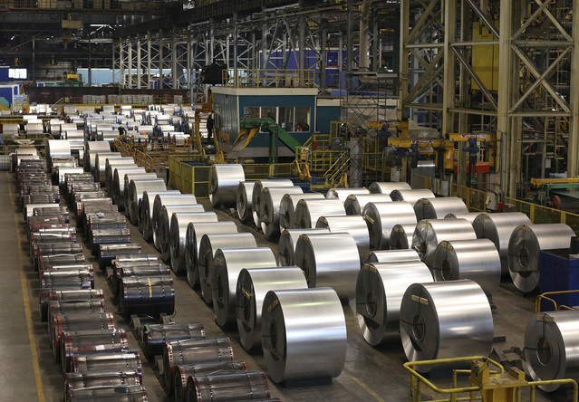
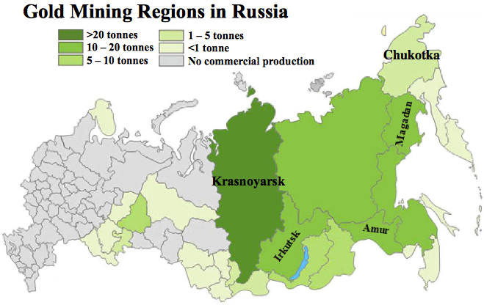
Russia
Industries
Mining
Leading Producer/Exporter of gold, minerals, and metals
Manufacturing/Factories
Machinery and Steel Products
Hydroelectric Power
Volga River

Slide 18
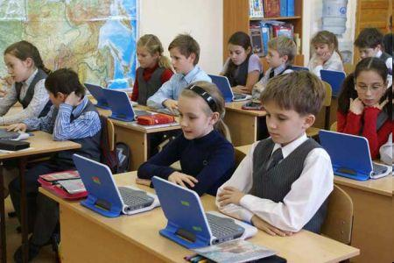
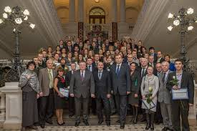
Russia
Literacy Rate
99.7%
Russia has emphasized education, especially science and math since the Soviet Union
However, Russia’s economy struggles still
Unemployment Rate
5.8%
Poverty Rate
16%

Slide 19
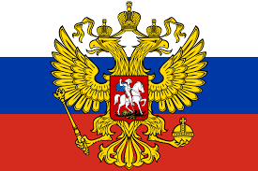
Russia
Gross Domestic Product
$2.097 trillion
Gross Domestic Product Per Capita
$14,611 per Russian citizen

