Slide 1
The Cold War

Slide 2
The Cold War
Superpowers
At the end of WWII, the Soviet Union and the United States emerged as the world’s new “Superpowers”
Superpowers: the most powerful and influential nations (politically and military)
Even though they had been allies, distrust developed between the two countries
USA did not want USSR (Soviet Union) to expand their territory and communism
Different beliefs and political systems
Communism vs. Democracy

Slide 3
The Cold War
After World War II...
Germany is divided in 4 occupation zones
USSR (Soviet Union) and USA disagree on how to run their zones
Containment: US government’s policy to contain communism to eastern Europe
US did not want communism to spread
They must assist Eastern Europe economically and politically
Defense Alliances
NATO: North Atlantic Treaty Organization
Warsaw Pact: defense pact for the satellite countries of the Soviet Union and the USSR
Satellite countries: communist countries under control of the Soviet Union (East Germany)

Slide 4
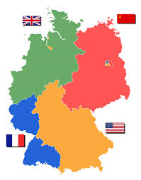

Slide 5
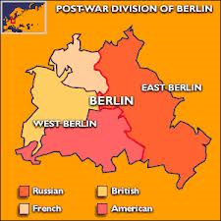

Slide 6
The Cold War
Two features symbolized the separation between communism in the East and democracy in the West:
Iron Curtain: In 1946, Winston Churchill warned of an “Iron Curtain”
Iron Curtain referred to a dividing line that had fallen between Eastern and Western Europe
Ideological and Physical border
Berlin Wall: wall built to divide East and West Germany in 1961

Slide 7
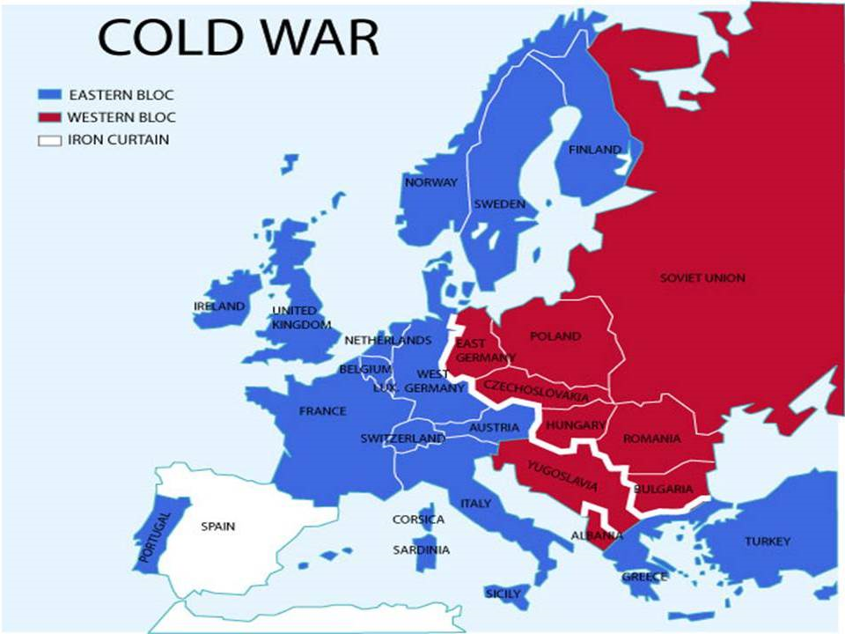

Slide 8
The Cold War
The Berlin Wall
Built throughout the night on August 13, 1961
Border wouldn’t open until November 1989
Families were divided between East and West
Built to stop travel out of communist East Germany
After the Wall was built, thousands tried to escape; hundreds died attempting it
Included guard towers, barbed wire, and a “death strip”

Slide 9
The Cold War
Mikhail Gorbachev
Leader of the Soviet Union who came to power in 1985
Represented a change in the Soviet Union
Wanted to modernize economy and decrease military
Economies in the East still got worse...
Increased protests
Gorbachev said if there were rebellions abroad, he would not send aid

Slide 10
The Cold War
Fall of the Berlin Wall
In 1989, there were weeks of riots and unrest in East Germany
East Germany’s communist government finally relaxed its travel restrictions
German citizens celebrated and began to take apart the Berlin Wall
Gorbachev did not send troops to help them and the East Germans gave up their power
November 9, 1989: Berlin Wall is opened
October 3, 1990: East and West Germany are reunited

Slide 11
The Cold War
End of the Soviet Union
In 1989, a series of revolutions overthrew communist governments
Gorbachev did not send in troops to stop it
The USSR formally disbanded in December 1991
The former union was split into 15 nations and the Cold War ended

