Slide 1
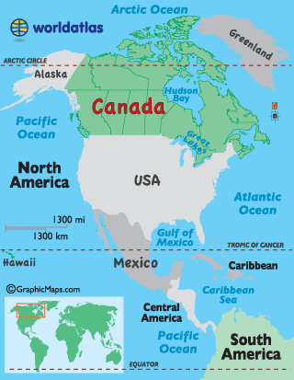
Canada
Location
North America
Directly north of the United States
2nd largest country by land size
Population
35.16 million people
Currency
Canadian Dollar

Slide 2
Canada
Economic System
Canada has a Mixed Economic System
Their system is closer to a Market system
There are few government controls and it is very easy to start new businesses
Government controls things like the Postal System and Healthcare
Since World War II, Canada has changed from focusing on agriculture to focusing on industry

Slide 3
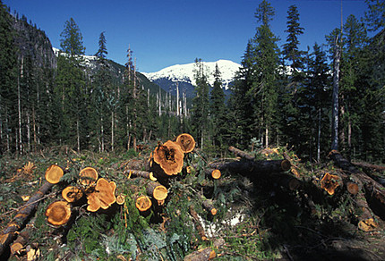
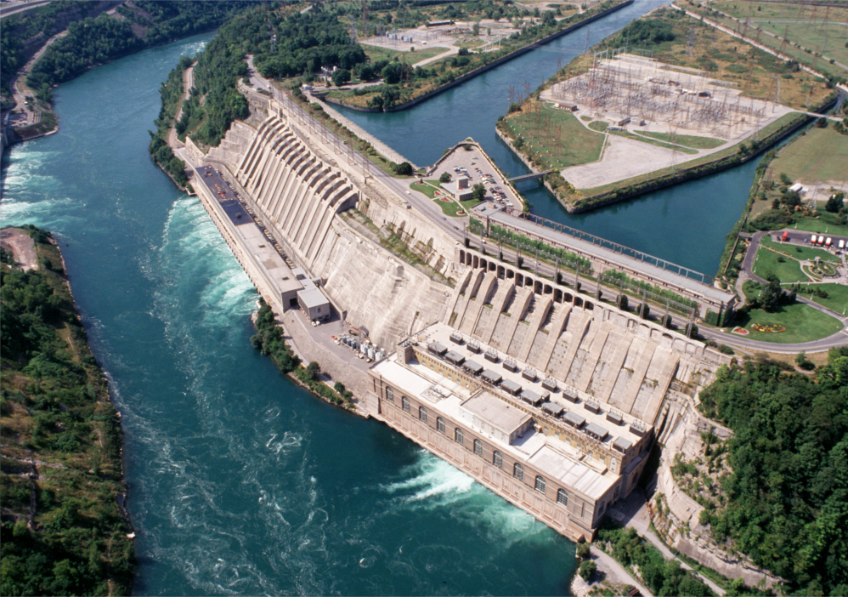
Canada
Natural Resources
Timber
34% of the land is forests
Fresh Water
Hydroelectricity
Minerals
Iron Ore, Zinc, Copper, Gold, Diamonds, Silver
Arable Land
13.1% of the land in Canada is good for growing crops

Slide 4
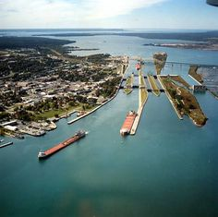
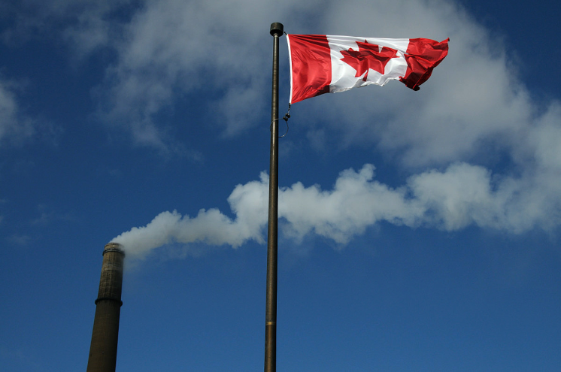
Canada
Industries
Manufacturing/Factories
Mainly located on the Great Lakes or St. Lawrence River
Timber
Mining
Over-extraction of resources in the Canadian Shield is limiting business
Tourism
Hydroelectric Power
World leader in trade
Access to 3 oceans, Great Lakes, and St. Lawrence River

Slide 5
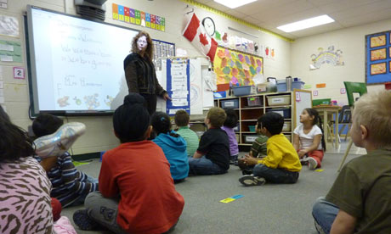
Canada
Literacy Rate
99.9%
School is mandatory for children until they are 16
Unemployment Rate
7.2%
Poverty Rate
10.8%

Slide 6
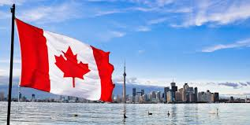
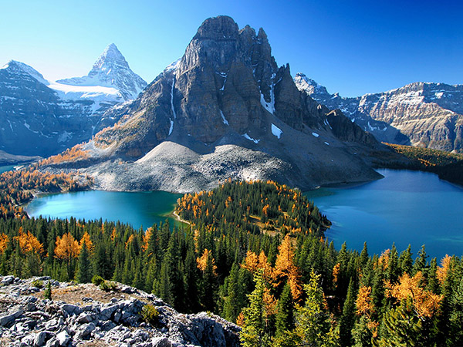
Canada
Gross Domestic Product
$1.827 trillion
Gross Domestic Product Per Capita
$51,958 per Canadian citizen

