Slide 1
Latin America: Aztecs & Incas

Slide 2
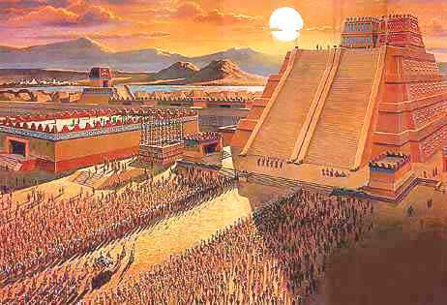
The Aztec Civilization
Ancient Civilization located in present day Mexico
Most powerful from the 1200’s to the 1500’s
Eventually defeated in 1572
Who were the Aztecs?
Capital City: Tenochtitlan
Known for their artwork and architecture
Most powerful group conquered other tribes
Conquered tribes paid taxes
Religion: believed in multiple Gods
Human and Animal sacrifice
Complex society
Mathematical system, Unique calendar, and Farming system

Slide 3
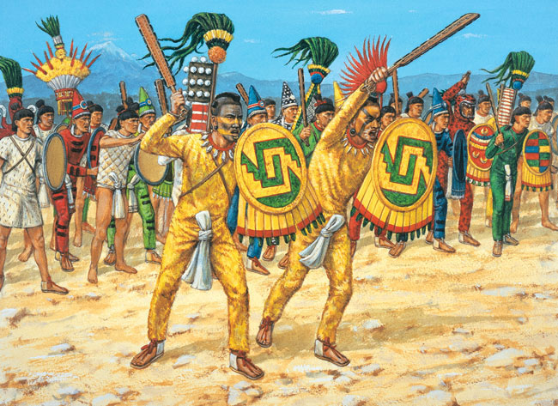
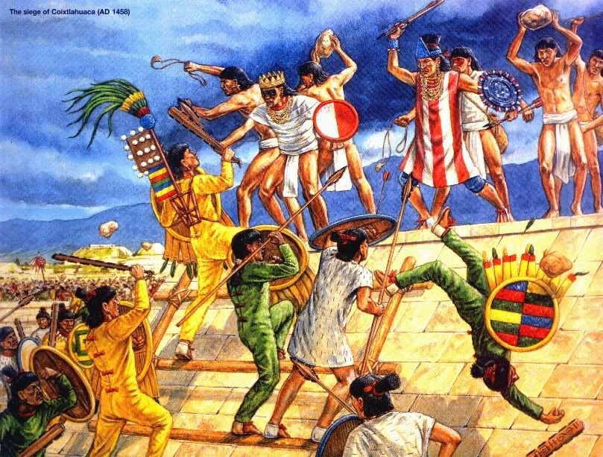
The Aztec Civilization
Aztecs and Warfare
Mexica was the most dominant warrior tribe
They conquered and controlled the other tribes
Aztecs encouraged warfare to maintain power and to please the God of War

Slide 4
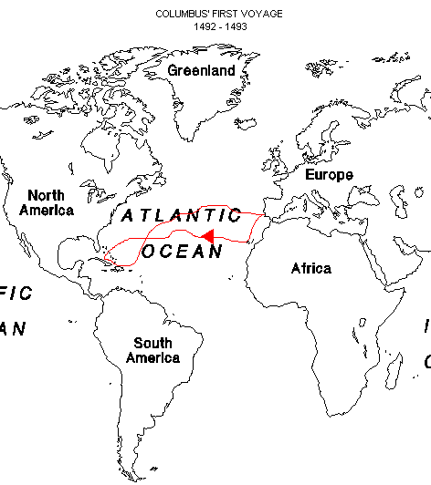
Meanwhile in Europe...
European countries wanted to explore the rest of the world and create large empires
Why did they want to create large empires?
God, Gold, and Glory
Spain hired Christopher Columbus to explore and find a new trade route to Asia to buy spices
Instead, Columbus discovered the “New World” in 1492
This New World was Latin America

Slide 5
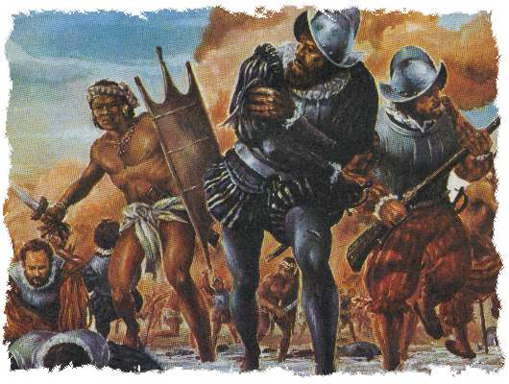
The Aztec Civilization
Instead of travelling to Asia, Spain decided to establish colonies in South America
They sent Conquistadors to take over the land from native people
Conquistador = Conqueror
Hernan Cortes was sent to settle Mexico, where the Aztecs lived

Slide 6
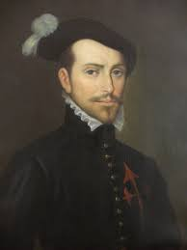
Hernan Cortes Conquers the Aztecs
Important Names
Hernan Cortes: Conquistador who conquered Aztecs
Montezuma II: ruler of the Aztec Empire
Cortes and the Spanish conquered Aztecs in 1521
Cortes became allies with tribes who hated Aztecs
Aztecs had enemies, because they were brutal to the surrounding tribes they defeated
Cortes captured the Aztec ruler, Montezuma II
Montezuma II welcomed Cortes into their capital
Spain claimed control of the Aztec empire

Slide 7
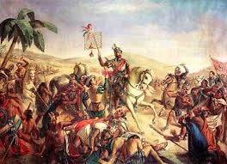
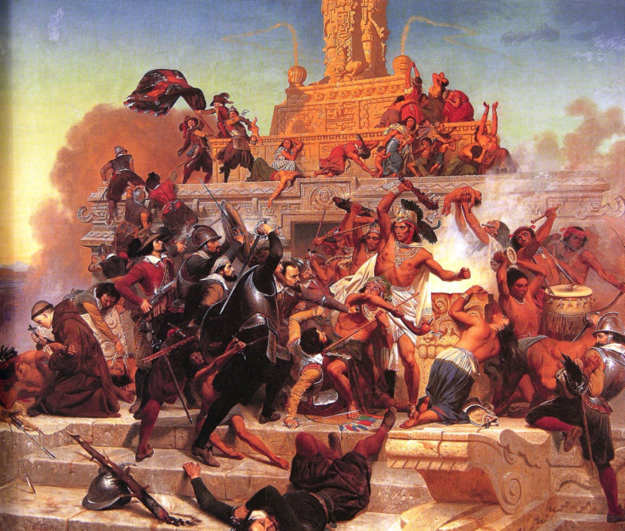
Hernan Cortes Conquers the Aztecs
Why was Cortes able to defeat the Aztecs with an army of only 1,000 Spanish men?
Spanish had better weapons
Aztecs had clubs, arrows, and spears
Spanish had swords, armor, cannons, guns, and horses
Cortes teamed up with other tribes
European diseases wiped out the Aztecs
Aztecs had no immunity, because they weren’t exposed to those diseases
Smallpox killed 90% of Aztecs

Slide 8
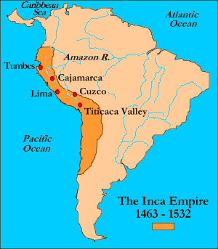
Inca Civilization
Powerful civilization located along the western coast of South America
Located in Andes Mountains
Present day Peru, Colombia, Ecuador, Bolivia, and Chile
Incas became powerful during the 1400s
The Incas conquered other tribes surrounding them
Incas are known for being powerful, intelligent, and innovative
Wealthiest in Latin America
Gold, Silver, and Bronze jewelry

Slide 9
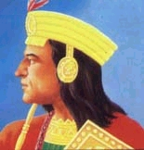
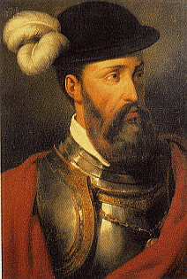
Francisco Pizzaro Conquers the Incas
Important Names
Francisco Pizarro: Spanish Conquistador who defeated the Incas
Atahualpa: last ruler of the Incas
In the 1500s, the Incas were defeated by Pizarro and the Spanish
Pizarro was sent by Spain to explore the west coast of Spain
Atahualpa was captured and then executed
The Incas were defeated for the same reasons as the Aztecs
Spain had more advanced weapons and diseases

Slide 10
Who Fought Who?????
Hernan
Cortes
1519
Montezuma II
Atahualpa
Francisco
Pizarro
1532

Slide 11
Columbian Exchange
Columbian Exchange: an exchange of goods and ideas between European countries and their colonies in North and South America.
Basically the Old World (Europe, Africa and Asia) began trading with the New World (North/South America)

Slide 12
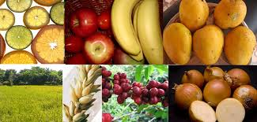
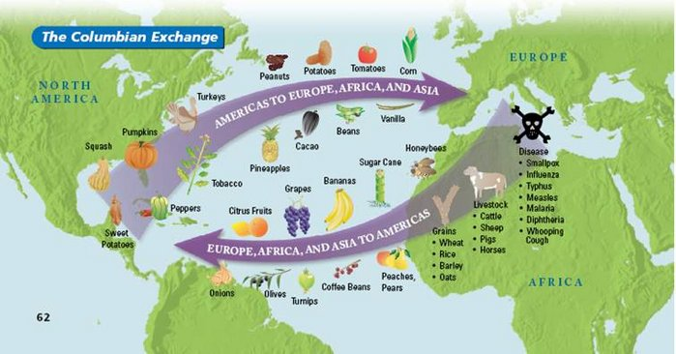
Columbian Exchange
Native Americans introduced the following to Spain:
Crops: beans, potatoes, squash, and maize (corn) peppers, tomatoes to Spain

Slide 13
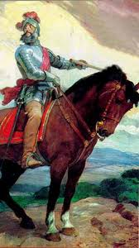
Columbian Exchange
Spain were introduced the following to Native Americans:
Animals/Food: Horses, pigs, peaches
Clothes made from Spain
Disease: Smallpox killed many of the indigenous (native) population
Christianity: Many Natives Americans were forced to become Christians

Slide 14
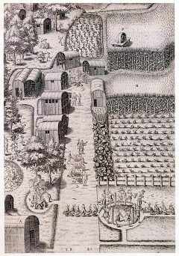
Columbian Exchange
The Columbian Exchange led:
An increase in farming in the New and Old World
Decline of Native population in Latin America (smallpox)
The horse being used by Natives in everyday life

