Slide 1
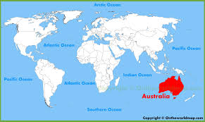
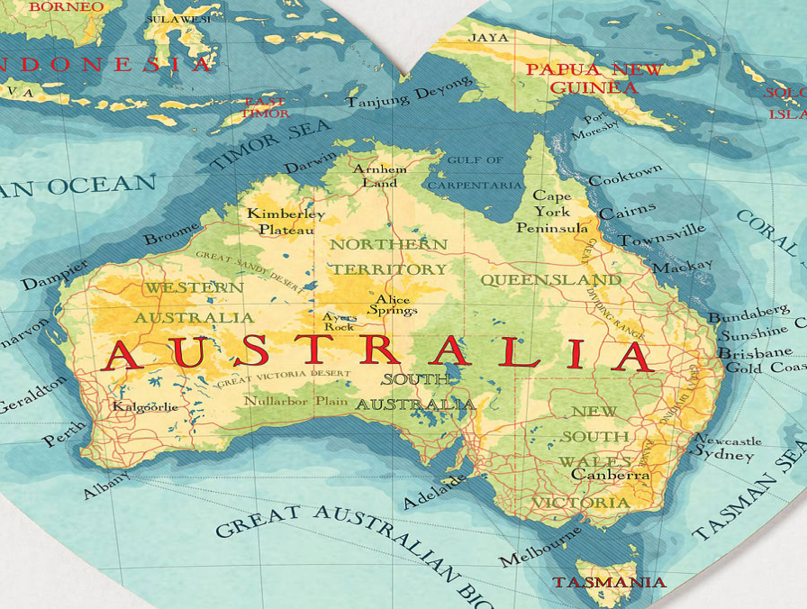
Australia
Location
Island, Country, and Continent
Southeastern Hemisphere
Bordered by Pacific Ocean, Indian Ocean, and Southern Ocean
Population
23.13 million
Currency
Australian Dollar

Slide 2
Australia
Economic System
Australia has a Mixed Market Economic System
Australia’s economy is one of the freest economies in the world
Almost no government rules, laws, or controls over businesses and the economy
Very easy for citizens to start their own business

Slide 3
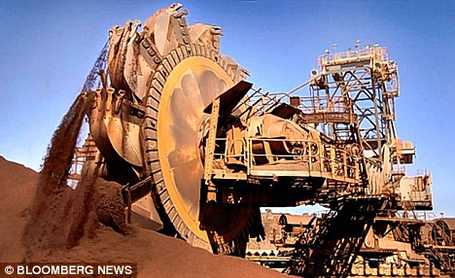
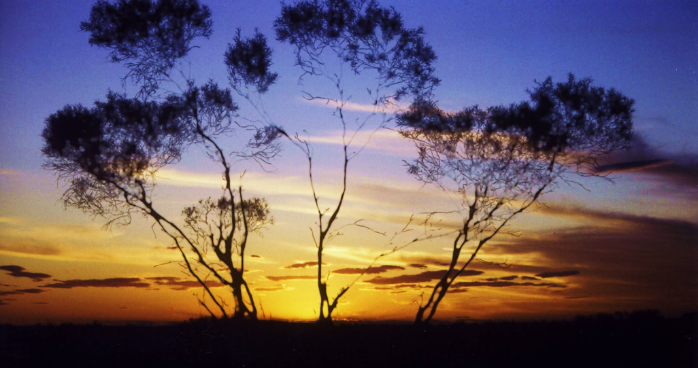
Australia
Natural Resources
Minerals
Gold, Silver, uranium, Coal, Copper, Iron Ore
Arable Land
6.2% of the land in Australia is good for growing crops
Large parts of Australia are deserts

Slide 4
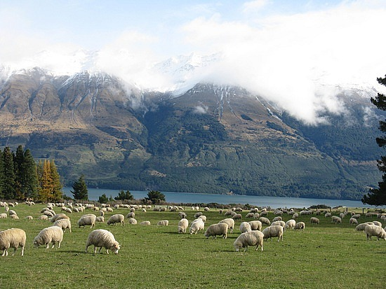
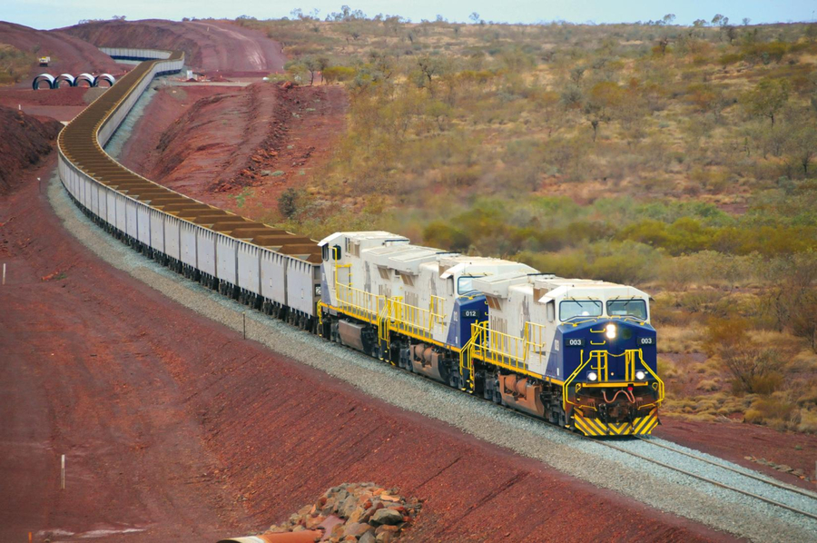
Australia
Industries
Mining
Australia is a leading exporter of minerals, especially Gold and Uranium
Sheep and Cattle Farms
Although the land isn’t good for crops, there are many sheep ranches
Tourism

Slide 5
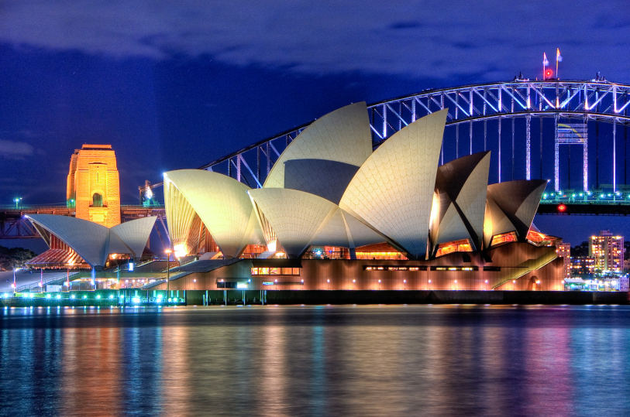
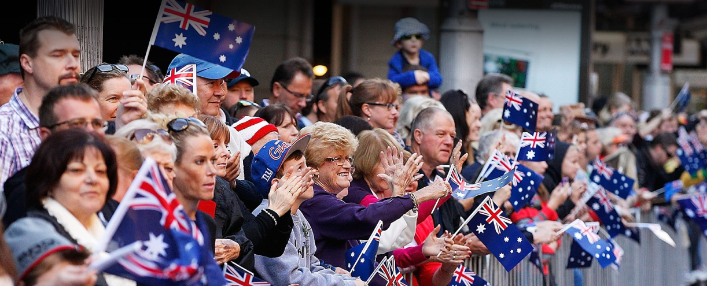
Australia
Literacy Rate
99.6%
Education is mandatory for children ages 5 – 17
Ranks 13th in the world for education
Unemployment Rate
6%
Poverty Rate
13.9%

Slide 6
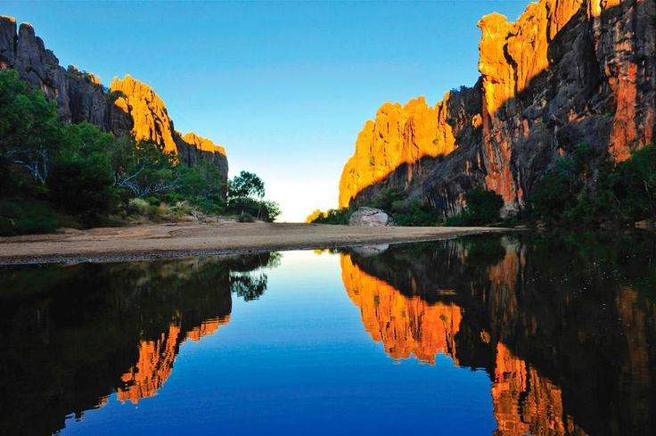
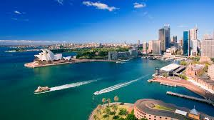
Australia
Gross Domestic Product
$1.56 trillion
Gross Domestic Product Per Capita
$67,458 per Australian citizen

