Slide 1
European History: Age of Exploration

Slide 2
Age of Exploration
SS6H6: the student will analyze the impact of European exploration and colonization on various world regions.
Identify the causes of European exploration and colonization; include religion, natural resources, a market for goods, and the contributions of Prince Henry the Navigator
Trace the empires of Portugal, Spain, England, and France in Asia, Africa, and the Americas
Explain the impact of European empire building in Africa and Asia on the outbreak of World War I

Slide 3
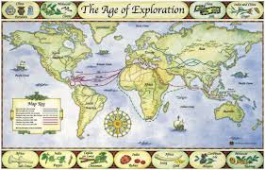
Age of Exploration
Life in Europe changed dramatically from the mid 1400s to the 1700s. This period of change was the Age of Exploration.
Europeans began to explore to find better trade routes to Asian markets and new natural resources

Slide 4
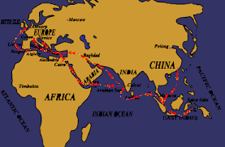
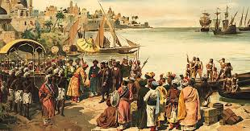
Age of Exploration
Spice Trade
Europeans had traveled to Asian ports for hundreds of years
Spices, silk, and other goods
Trade routes were controlled by Muslims and were very expensive to ship goods
Europeans wanted new, shorter routes to Asia
New Land and Natural Resources
European countries were competing for power
Needed new land and natural resources

Slide 5
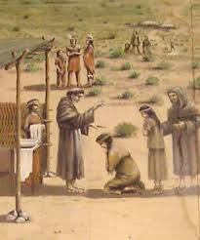
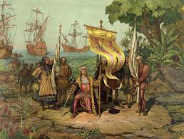
Age of Exploration
What were the 3 main motives for exploration?
God
Explorers, governments, and missionaries wanted to spread their Christian religion
Gold
Rulers of the different countries wanted to get rich and powerful from exploring new lands
Glory
Many explorers had a sense of adventure and wanted to become famous from exploring new lands

Slide 6
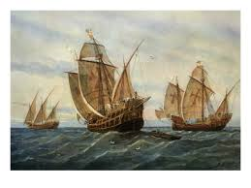
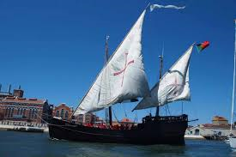
Age of Exploration
What made exploration possible at this time?
Renaissance Movement: the Renaissance brought a new curiosity about the rest of the world and learning
New Equipment and Technology
Caravels: smaller, sturdy ships
Mariner’s Compass
Better weapons (cannons and guns)
More accurate maps
Cartographers updated maps and kept detailed maps of new lands

Slide 7
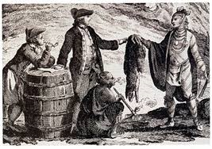
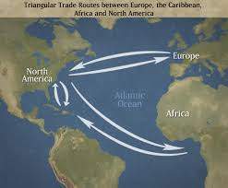
Age of Exploration: Triangle Trade
Triangle Trade: trade system between European countries, the west coast of Africa and colonies in the Americas (North and South America)
Exchange of goods, materials, and ideas
Europeans brought materials (horses and weapons) to Africa and the Americas
Slaves were taken from Africa to the colonies
Raw materials were brought back to Europe
Europeans unintentionally brought their culture and diseases with them too

Slide 8
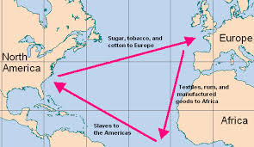

Slide 9
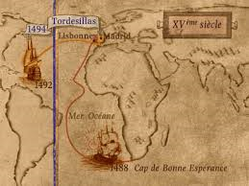
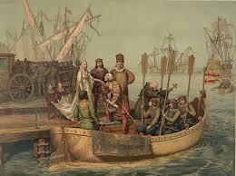
Age of Exploration
Portugal, Spain, England, and France led the way for exploration and colonization
Colonization: setting up a colony away from the homeland
Line of Demarcation: created by the Pope to keep Spain and Portugal from fighting over newly discovered lands
Divides the non-Christian world between the countries (lands to the east were Portugal’s and lands to the west were Spain’s)

Slide 10
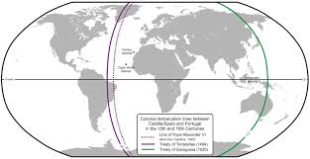

Slide 11
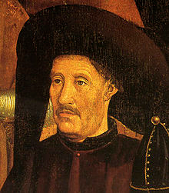
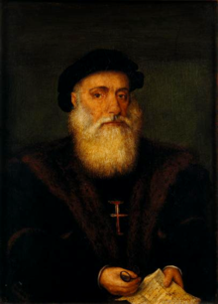
Age of Exploration: Portugal
Portugal led the way in exploration due to their experienced sailors and new technology.
Prince Henry the Navigator: Portuguese monarch who financed explorations and founded a School of Navigation
Vasco de Gama: Portuguese navigator who sailed around the Cape of Good Hope (Africa) in 1497 and went to India
First European to reach India by sea
Portugal had settlements in Brazil (South America) and along the coast in Africa and Asia

Slide 12
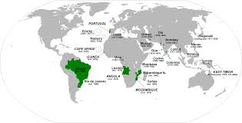

Slide 13
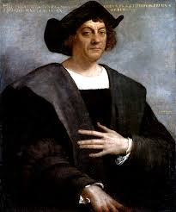
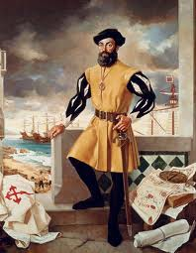
Age of Exploration: Spain
Christopher Columbus: Italian explorer who sailed for Spain
Reached the Caribbean islands in 1492 while trying to sail to Asia
Ferdinand Magellan: Portuguese explorer who sailed for Spain
Sailed southwest around the tip of South America in 1519
His crew sailed around the world, proving the earth was round
Established colonies in South America (Mexico and Peru) and in North Africa
Spread of Catholicism was important motivation

Slide 14
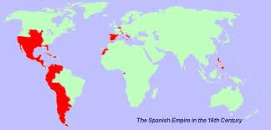

Slide 15
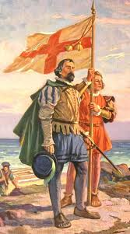
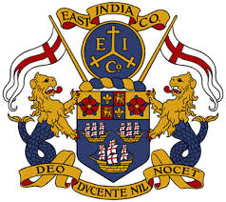
Age of Exploration: Great Britain
Great Britain was one of the most powerful empires in the world
Britain controlled 1/5 of the world’s land
It was called the empire on which “the sun never sets”
Settlements: coast of North America, Caribbean Islands, East Indies, and Australia
East India Company: British company made to trade in India and Southeast Asia
Mercantilism: colonies helped the mother country by providing natural resources and a market for goods

Slide 16
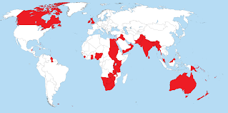

Slide 17
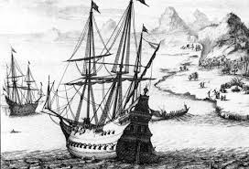
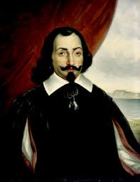
Age of Exploration: France
Samuel de Champlain: French explorer who founded the colony of Quebec as a trading post in 1608
Settlements: colony of Quebec in Canada, central part of North America, Louisiana, Caribbean Islands, and West Africa
Very interested in spreading their Catholic religion

Slide 18
